Slide 1

Course Financial Reporting & Statement Analysis
Topic Financial Reporting
Faculty Ujwal M S

Slide 2
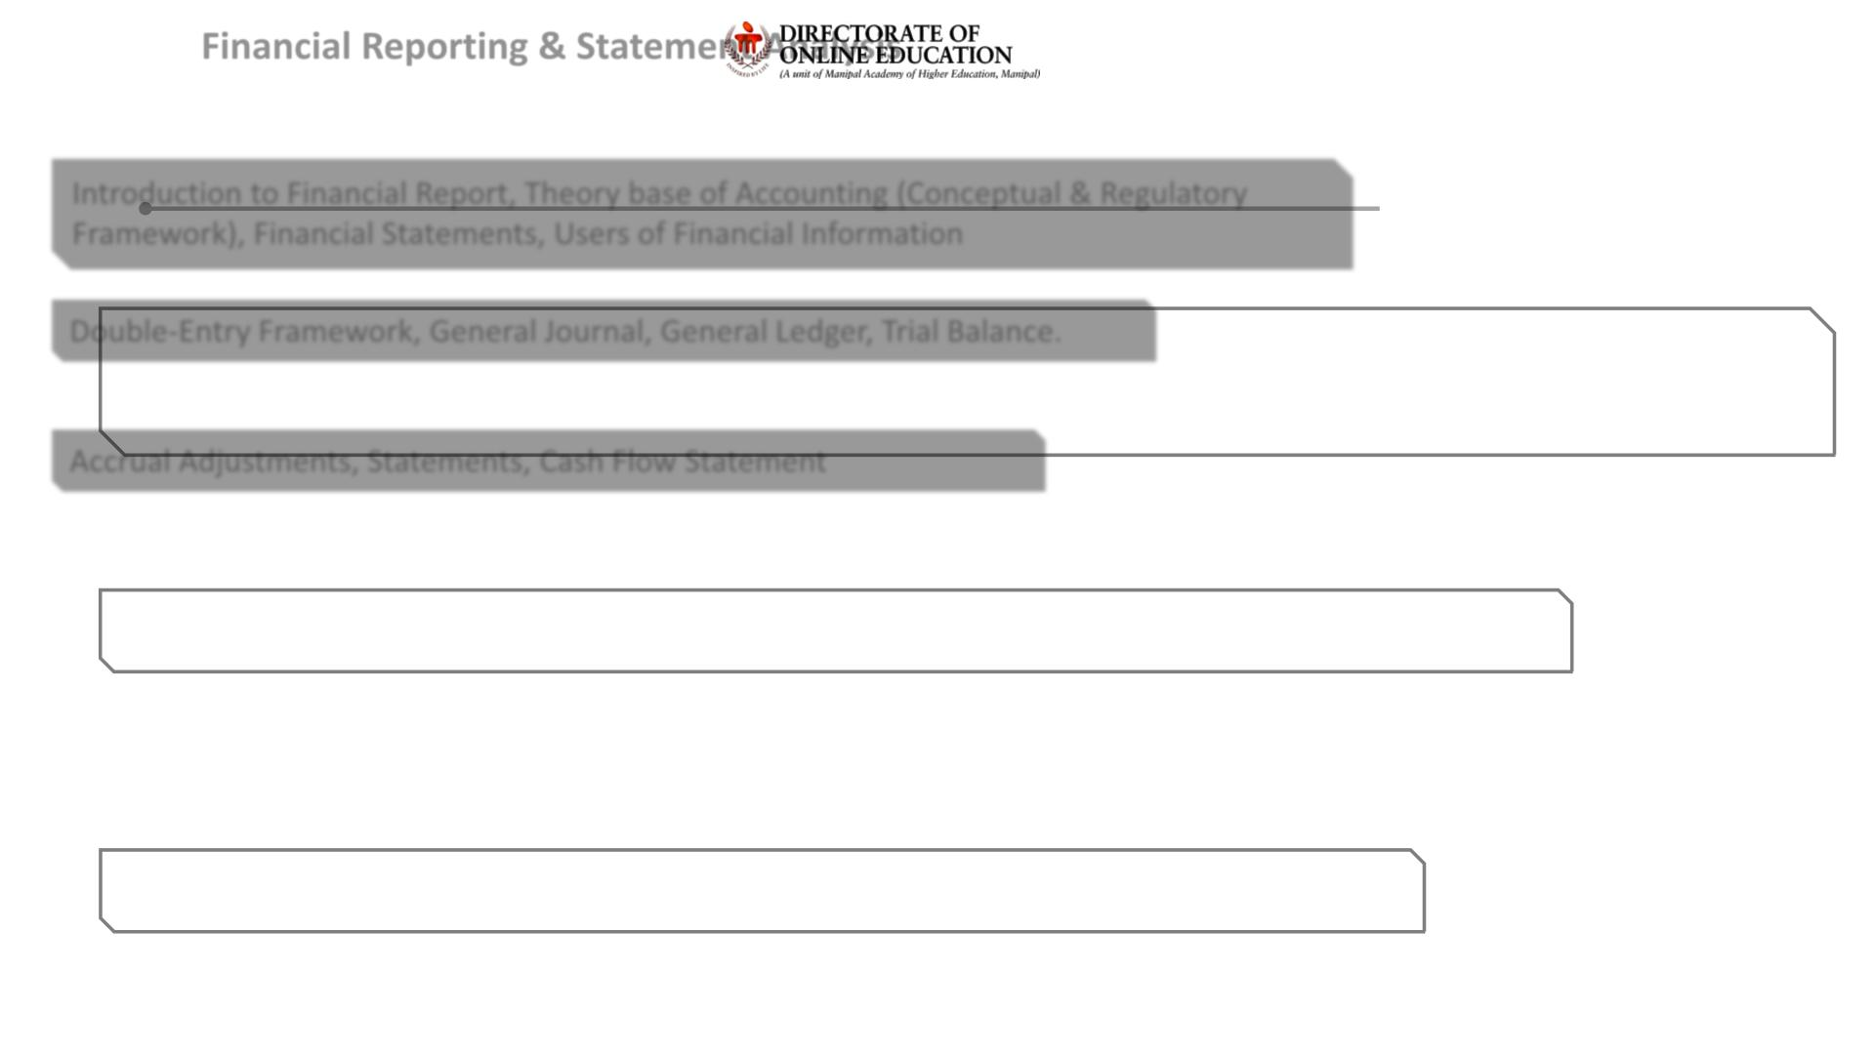
Financial Reporting & Statement Analysis
Overview of the Course Curriculum
Segment 1: Financial Reporting
Introduction to Financial Report, Theory base of Accounting (Conceptual & Regulatory
Framework), Financial Statements, Users of Financial Information
Segment 2: Accounting Process-Part I
Double-Entry Framework, General Journal, General Ledger, Trial Balance.
Segment 3: Accounting Process-Part II
Accrual Adjustments, Statements, Cash Flow Statement

Slide 3
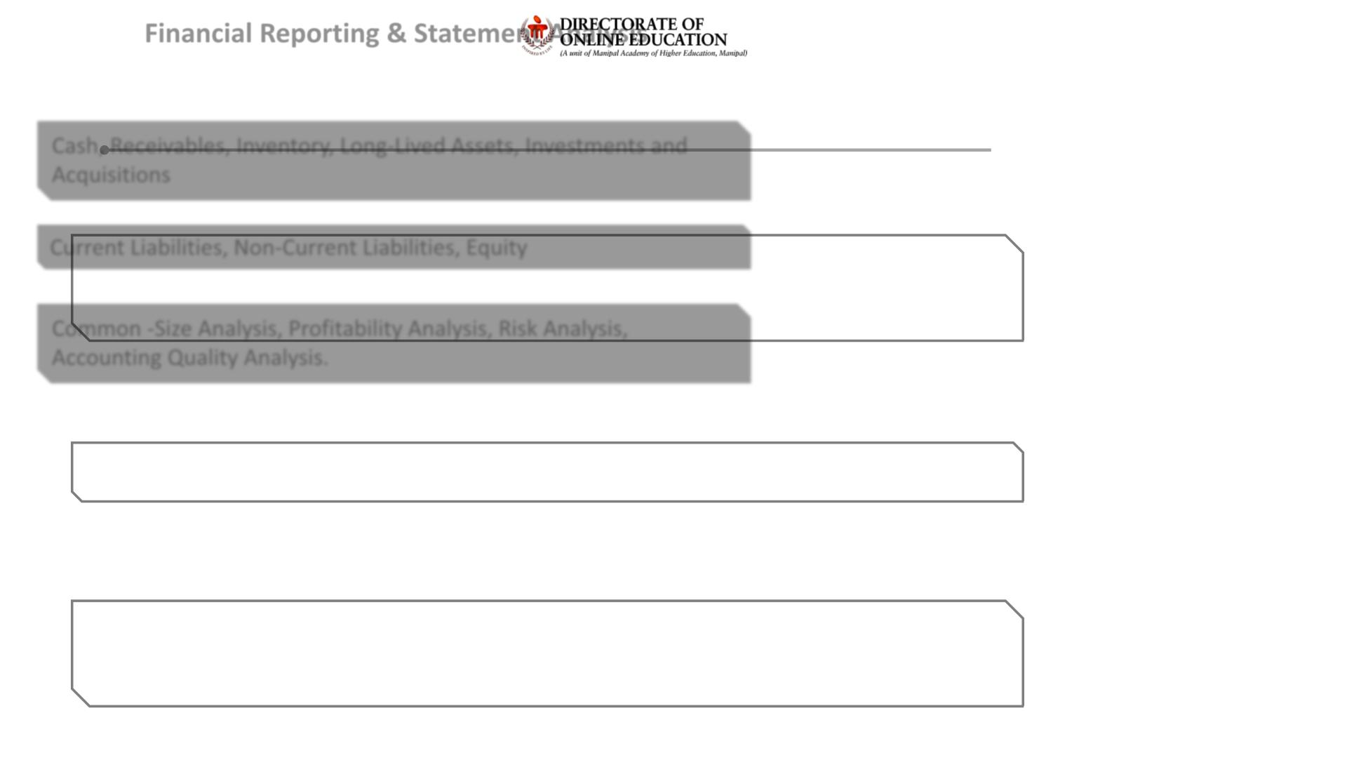
Financial Reporting & Statement Analysis
Overview of the Course Curriculum
Segment 4: Assets
Cash, Receivables, Inventory, Long-Lived Assets, Investments and
Acquisitions
Segment 5: Liabilities and Equity
Current Liabilities, Non-Current Liabilities, Equity
Segment 6: Statement Analysis
Common -Size Analysis, Profitability Analysis, Risk Analysis,
Accounting Quality Analysis.

Slide 4
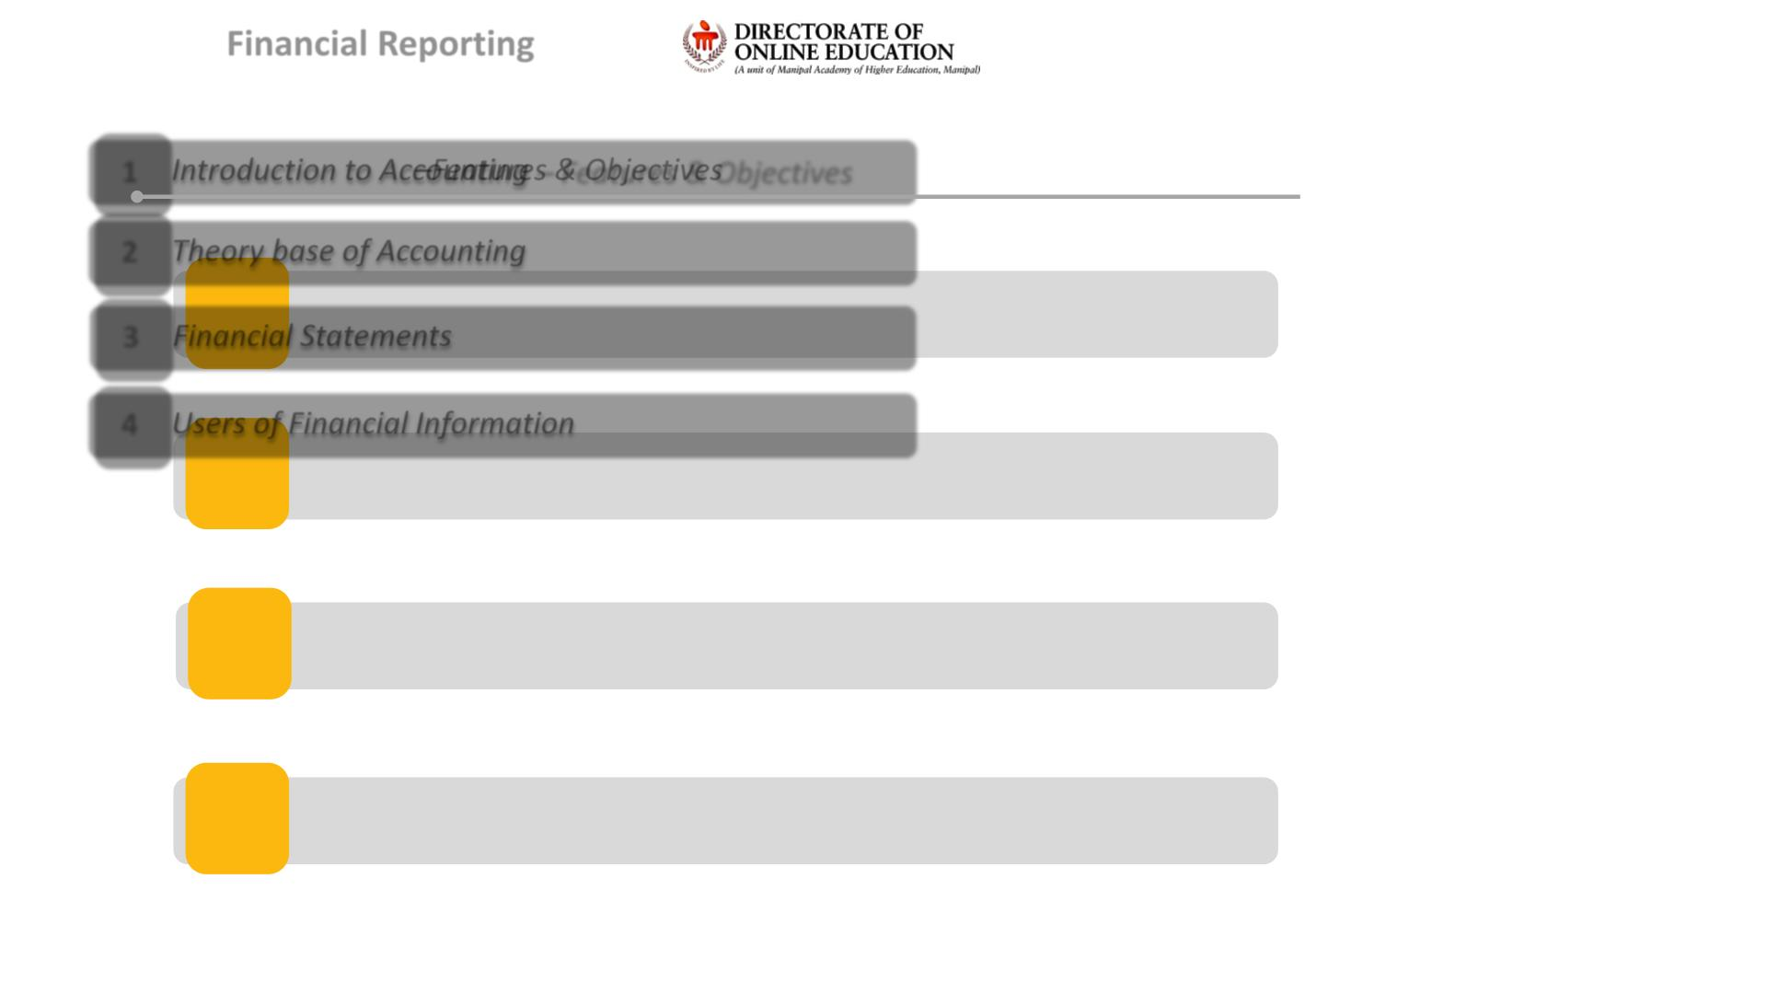
Financial Reporting
Overview of Topics
1 Introduction to Accounting – Features & Objectives
2 Theory base of Accounting
3 Financial Statements
4 Users of Financial Information

Slide 5
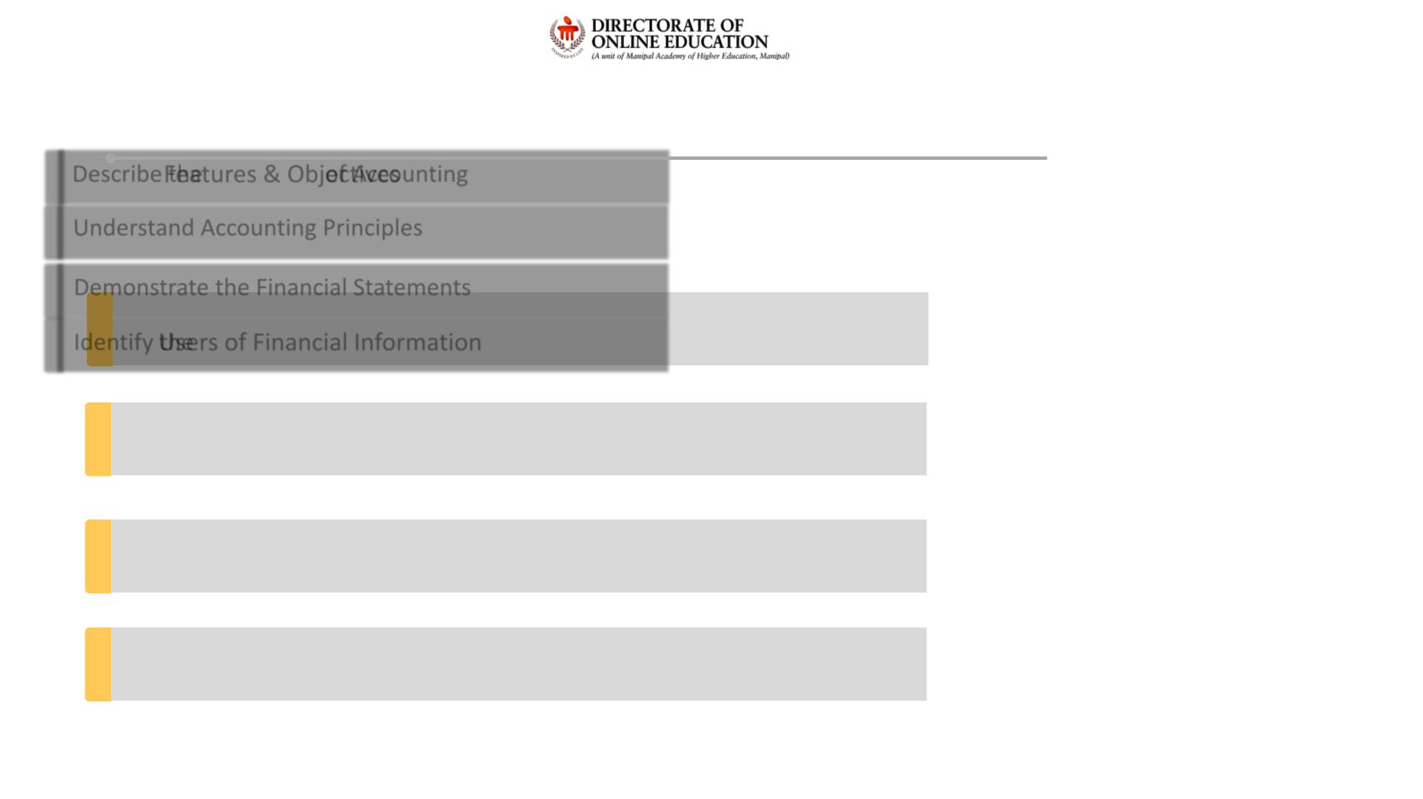
Learning Objectives
At the end of this session, you will be able to:
Describe the Features & Objectives of Accounting
Understand Accounting Principles
Demonstrate the Financial Statements
Identify the Users of Financial Information

Slide 6
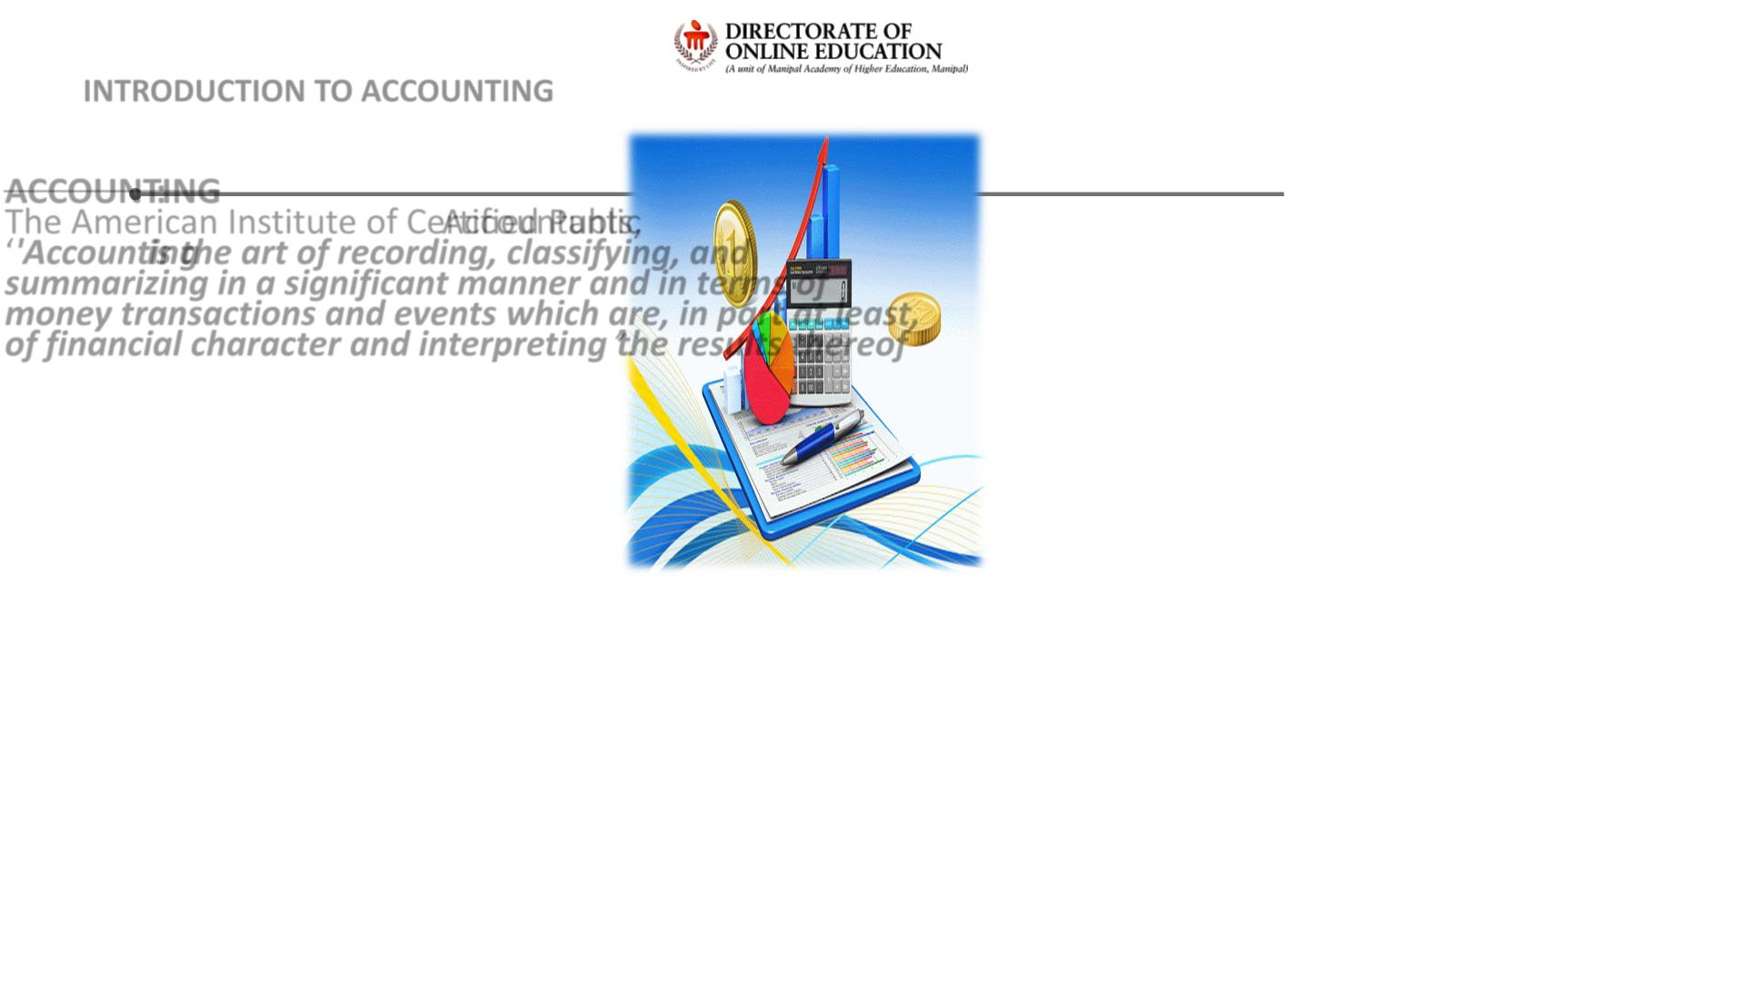
INTRODUCTION TO ACCOUNTING
ACCOUNTING:
The American Institute of Certified Public Accountants,
‘'Accounting is the art of recording, classifying, and
summarizing in a significant manner and in terms of
money transactions and events which are, in part at least,
of financial character and interpreting the results thereof’’.

Slide 7
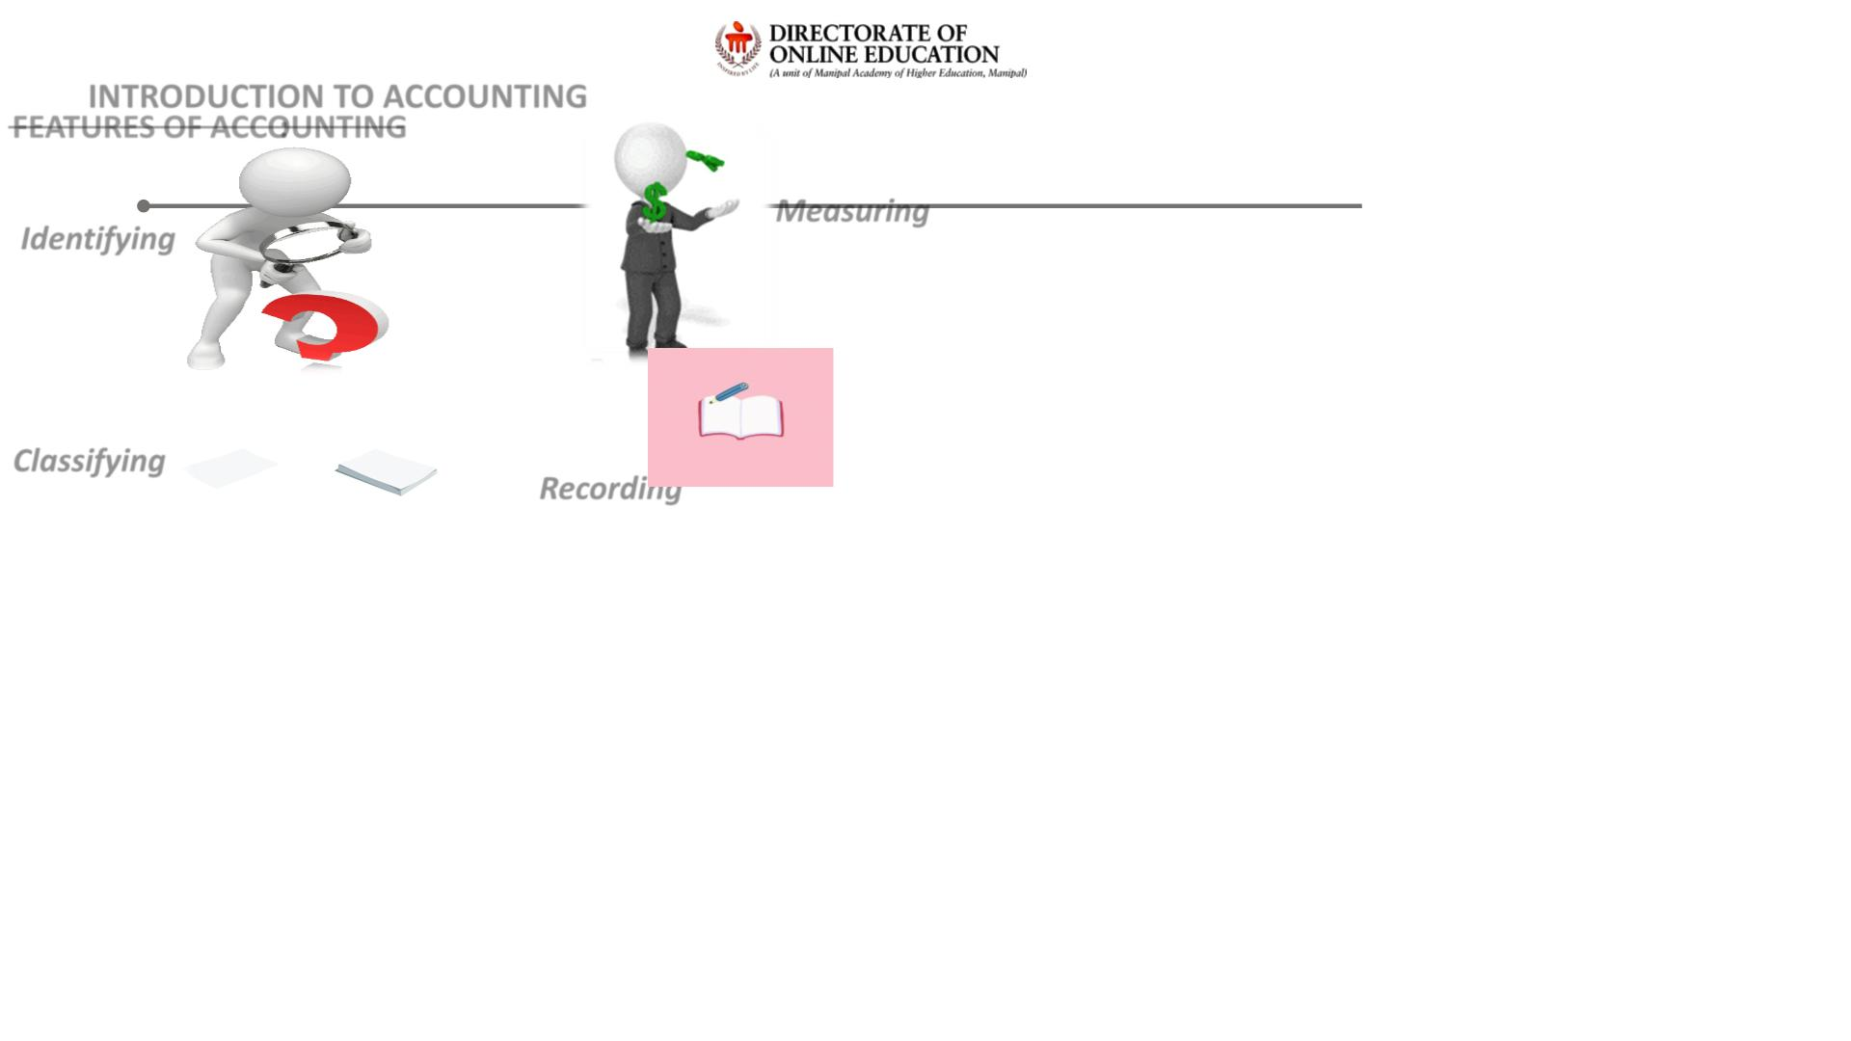
INTRODUCTION TO ACCOUNTING
FEATURES OF ACCOUNTING:
Measuring
Identifying
Classifying
Recording

Slide 8
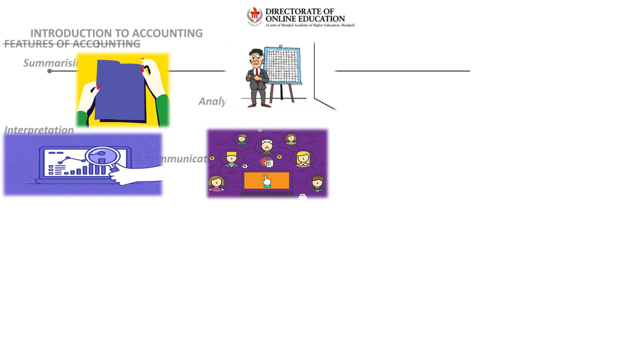
INTRODUCTION TO ACCOUNTING
FEATURES OF ACCOUNTING:
Summarising
Analysing
Interpretation
Communicating

Slide 9
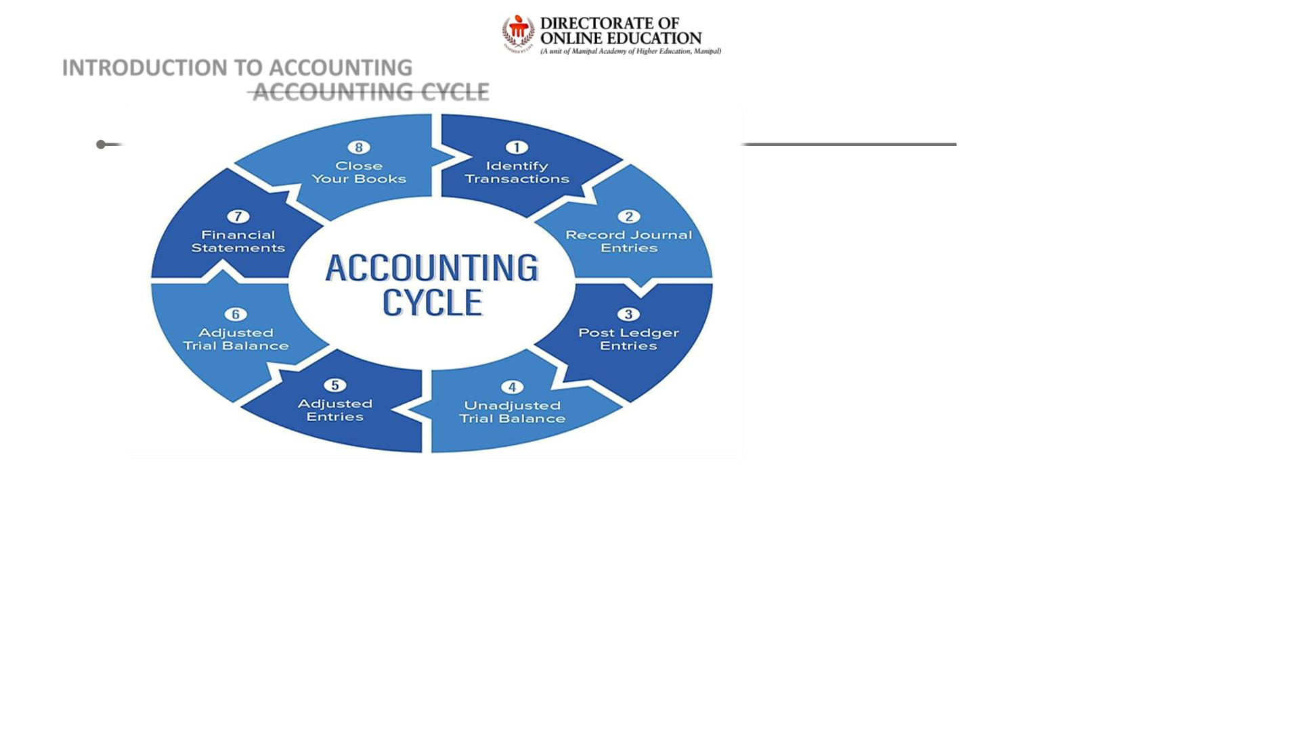
INTRODUCTION TO ACCOUNTING
ACCOUNTING CYCLE

Slide 10
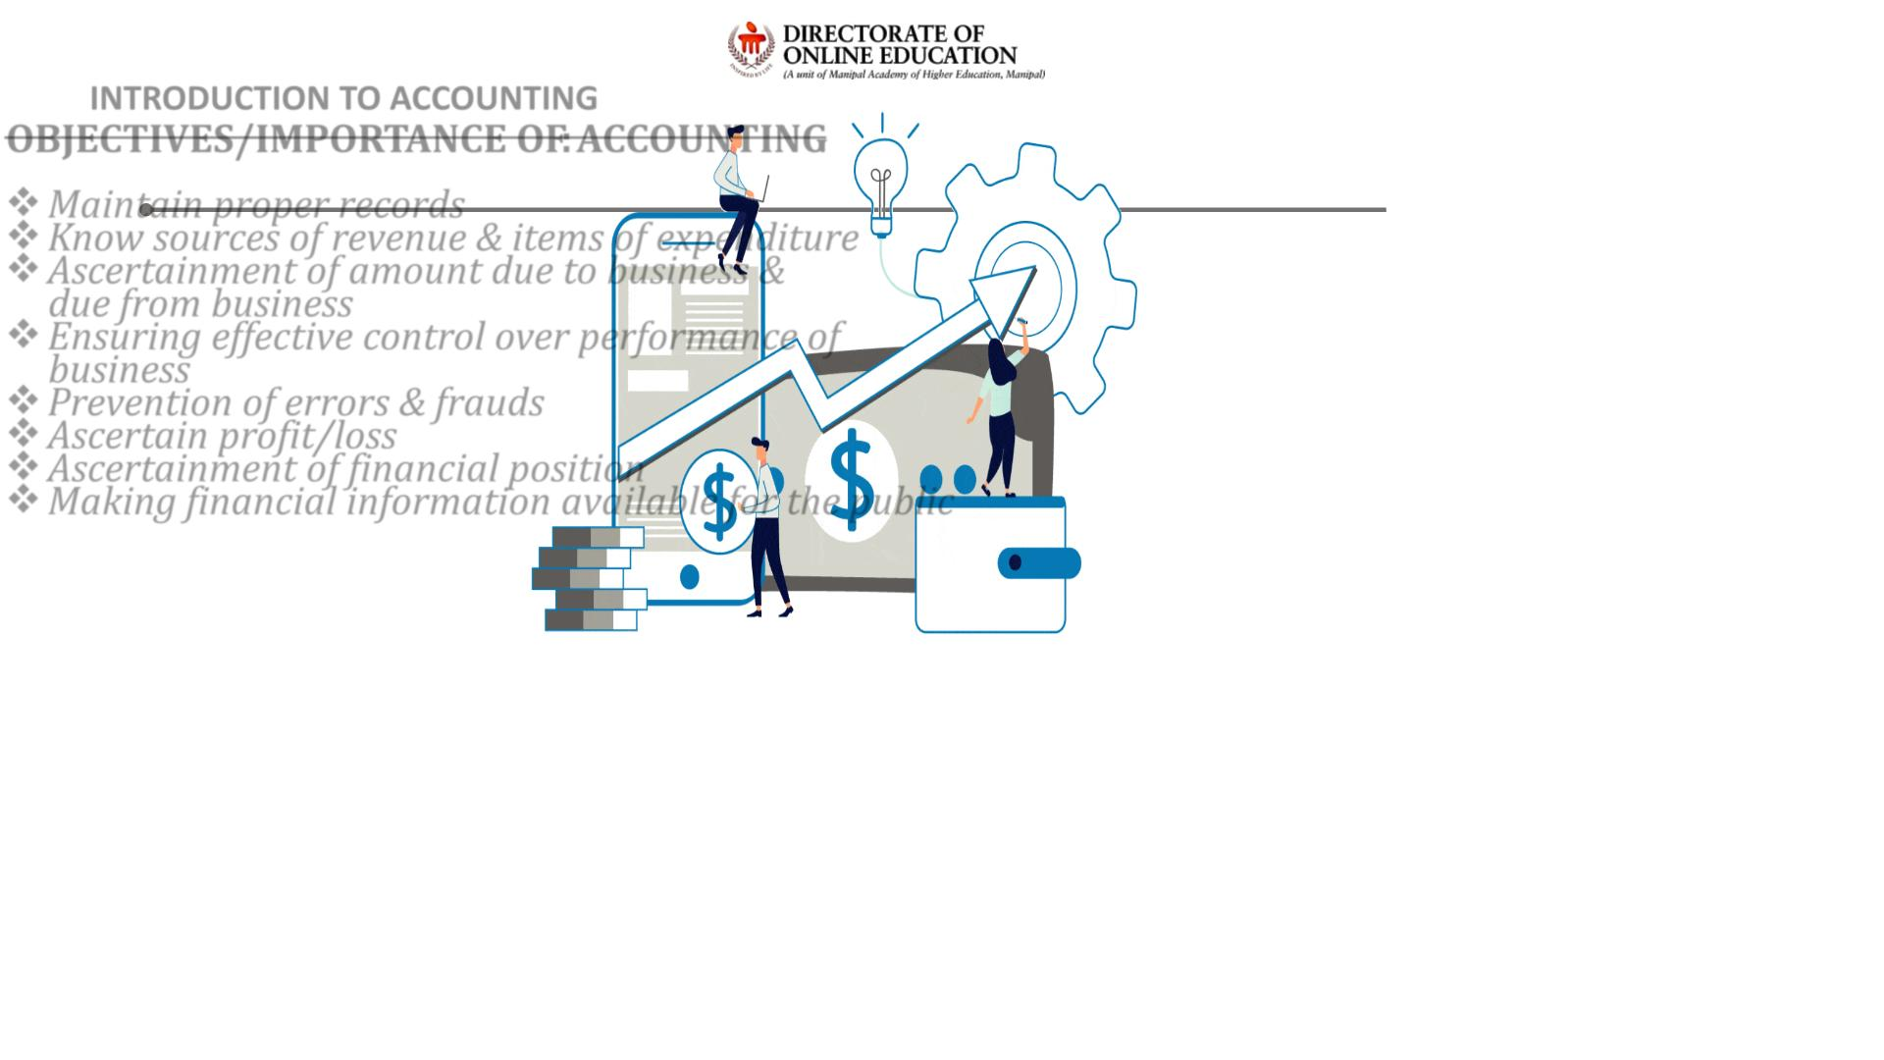
INTRODUCTION TO ACCOUNTING
OBJECTIVES/IMPORTANCE OF ACCOUNTING:
❖ Maintain proper records
❖ Know sources of revenue & items of expenditure
❖ Ascertainment of amount due to business &
due from business
❖ Ensuring effective control over performance of
business
❖ Prevention of errors & frauds
❖ Ascertain profit/loss
❖ Ascertainment of financial position
❖ Making financial information available for the public

Slide 11
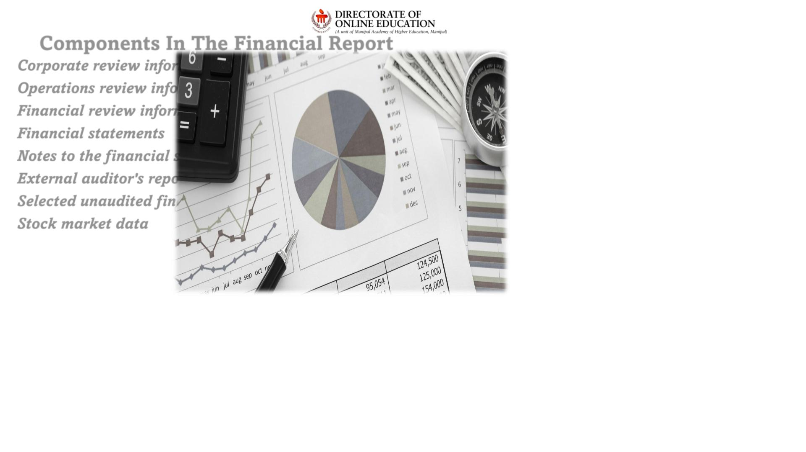
Components In The Financial Report
Corporate review information
Operations review information
Financial review information
Financial statements
Notes to the f inancial statements
External auditor's report
Selected unaudited f inancial data
Stock market data

Slide 12
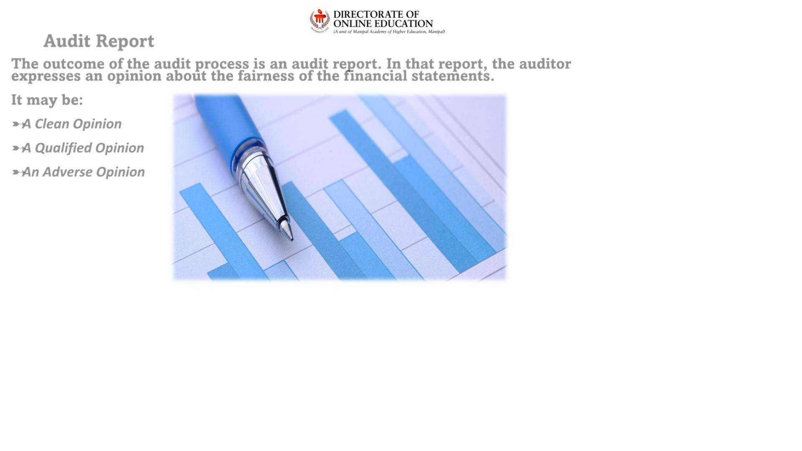
Audit Report
The outcome of the audit process is an audit report. In that report, the auditor
expresses an opinion about the fairness of the f inancial statements.
It may be:
➸A Clean Opinion
➸A Qualified Opinion
➸An Adverse Opinion

Slide 13
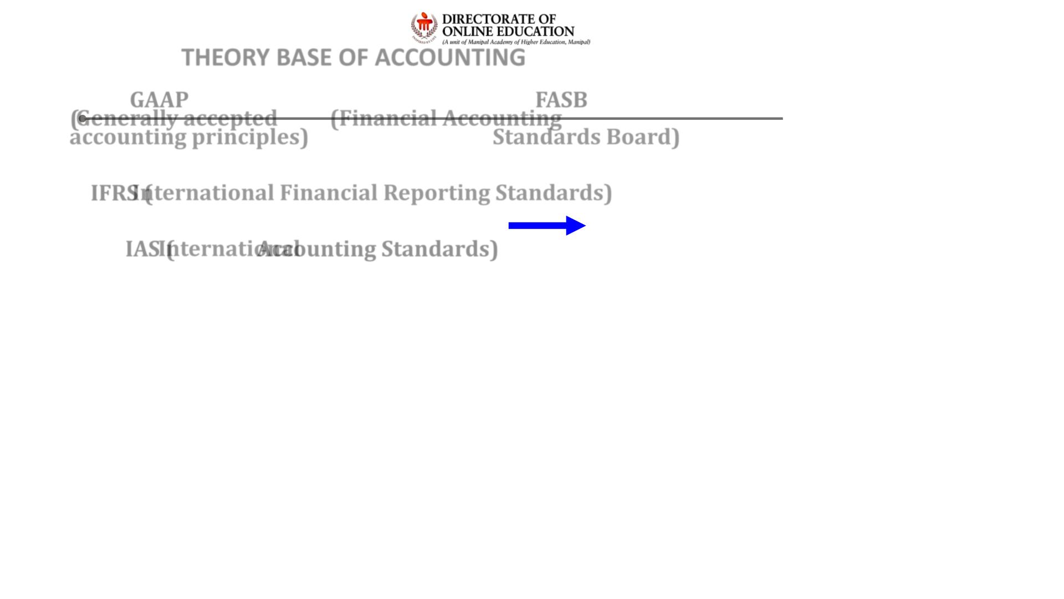
THEORY BASE OF ACCOUNTING
GAAP
FASB
(Generally accepted
accounting principles)
(Financial Accounting
Standards Board)
IFRS (International Financial Reporting Standards)
IAS (International Accounting Standards)

Slide 14
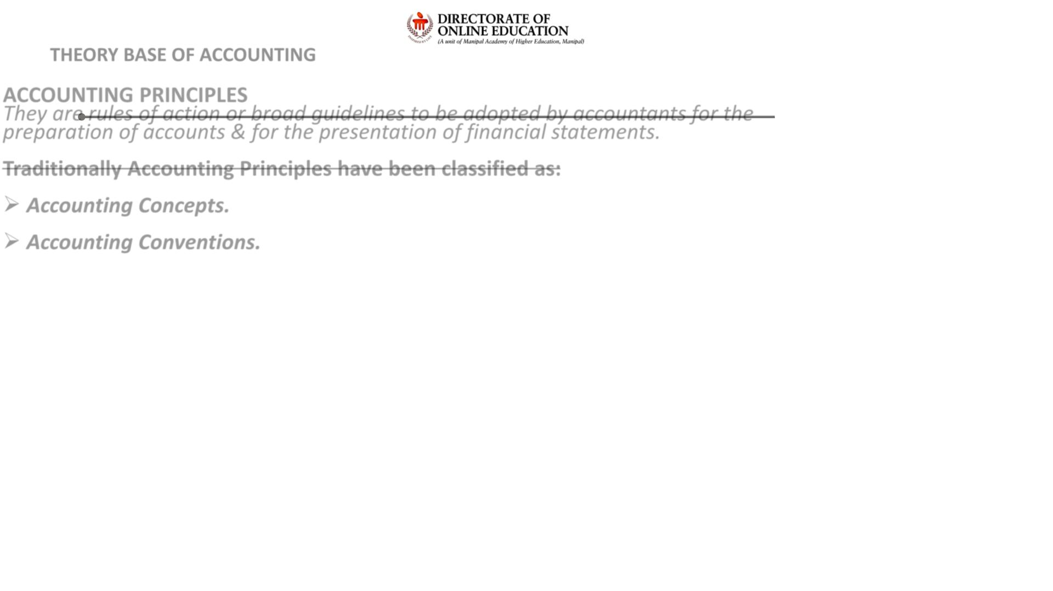
THEORY BASE OF ACCOUNTING
ACCOUNTING PRINCIPLES
They are rules of action or broad guidelines to be adopted by accountants for the
preparation of accounts & for the presentation of financial statements.
Traditionally Accounting Principles have been classified as:
➢ Accounting Concepts.
➢ Accounting Conventions.

Slide 15
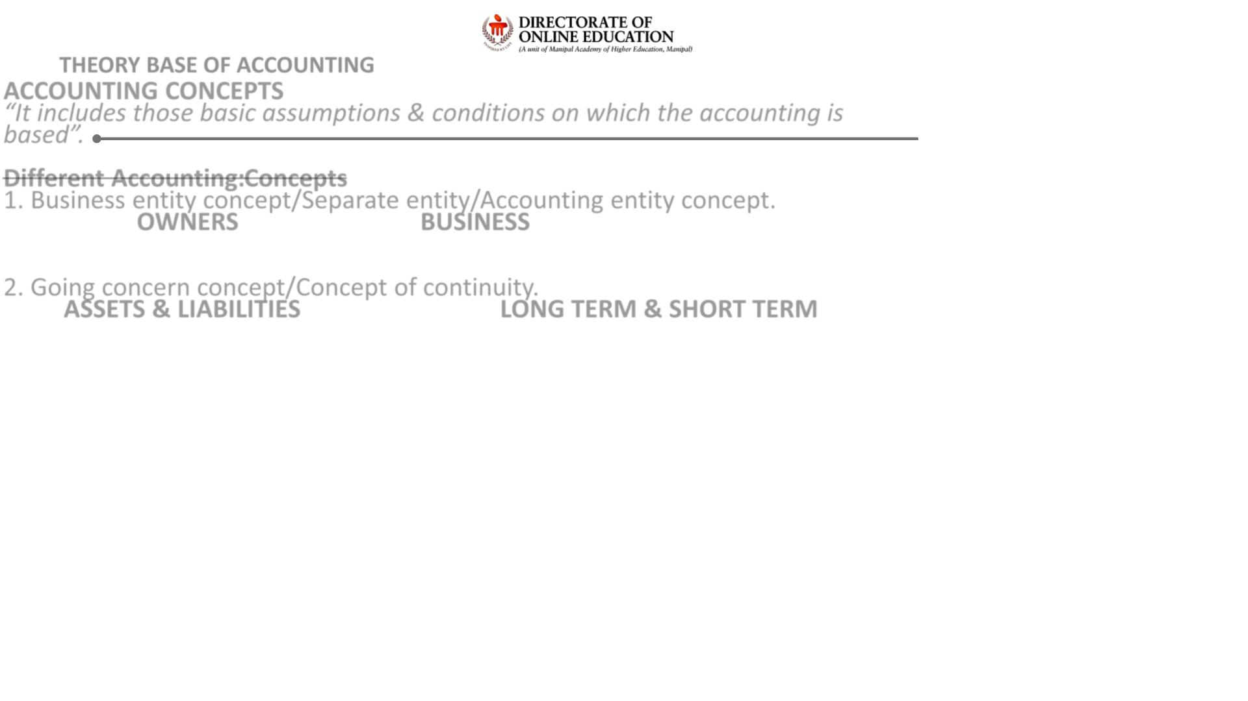
THEORY BASE OF ACCOUNTING
ACCOUNTING CONCEPTS
“It includes those basic assumptions & conditions on which the accounting is
based”.
Different Accounting Concepts:
1. Business entity concept/Separate entity/Accounting entity concept.
OWNERS
BUSINESS
2. Going concern concept/Concept of continuity.
ASSETS & LIABILITIES
LONG TERM & SHORT TERM

Slide 16
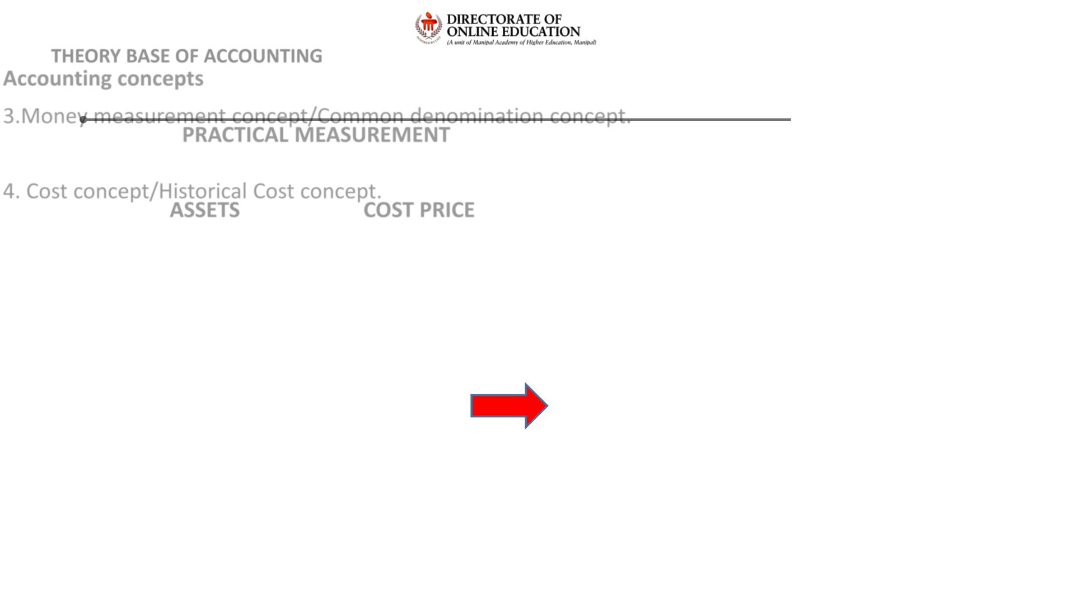
THEORY BASE OF ACCOUNTING
Accounting concepts
3.Money measurement concept/Common denomination concept.
PRACTICAL MEASUREMENT
4. Cost concept/Historical Cost concept.
ASSETS
COST PRICE

Slide 17
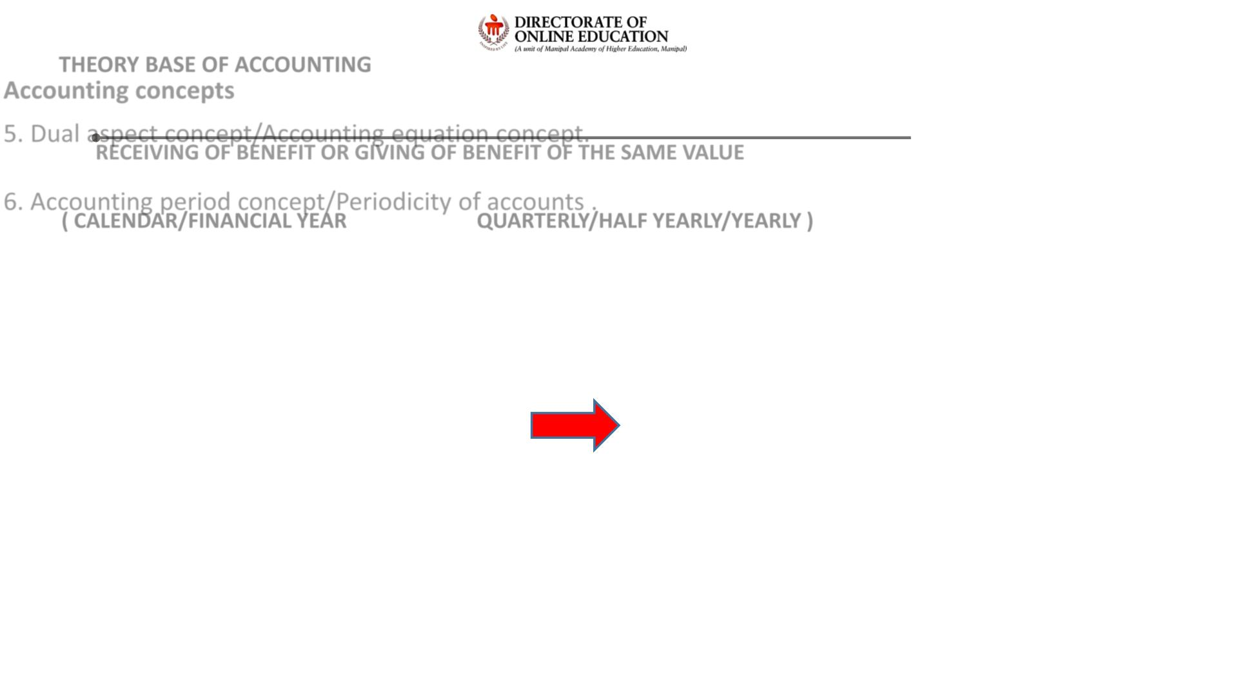
THEORY BASE OF ACCOUNTING
Accounting concepts
5. Dual aspect concept/Accounting equation concept.
RECEIVING OF BENEFIT OR GIVING OF BENEFIT OF THE SAME VALUE
6. Accounting period concept/Periodicity of accounts .
( CALENDAR/FINANCIAL YEAR
QUARTERLY/HALF YEARLY/YEARLY )

Slide 18
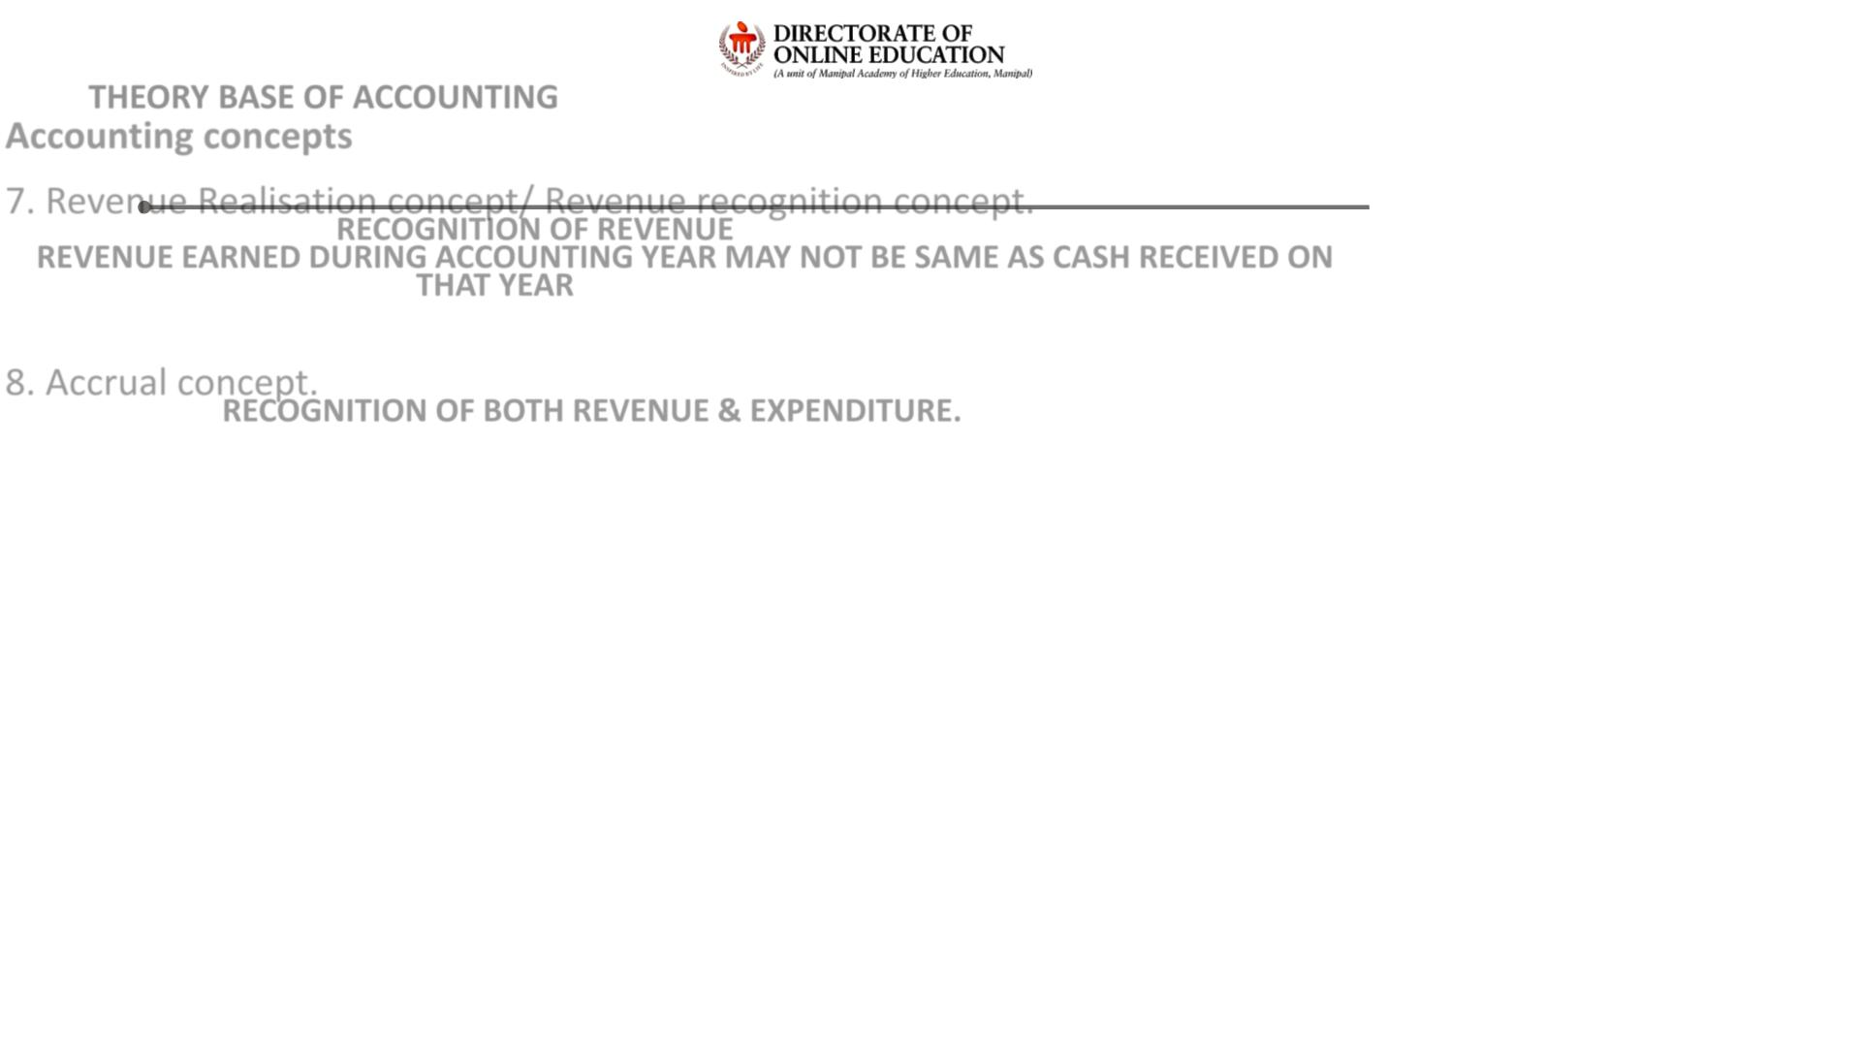
THEORY BASE OF ACCOUNTING
Accounting concepts
7. Revenue Realisation concept/ Revenue recognition concept.
RECOGNITION OF REVENUE
REVENUE EARNED DURING ACCOUNTING YEAR MAY NOT BE SAME AS CASH RECEIVED ON
THAT YEAR
8. Accrual concept.
RECOGNITION OF BOTH REVENUE & EXPENDITURE.

Slide 19
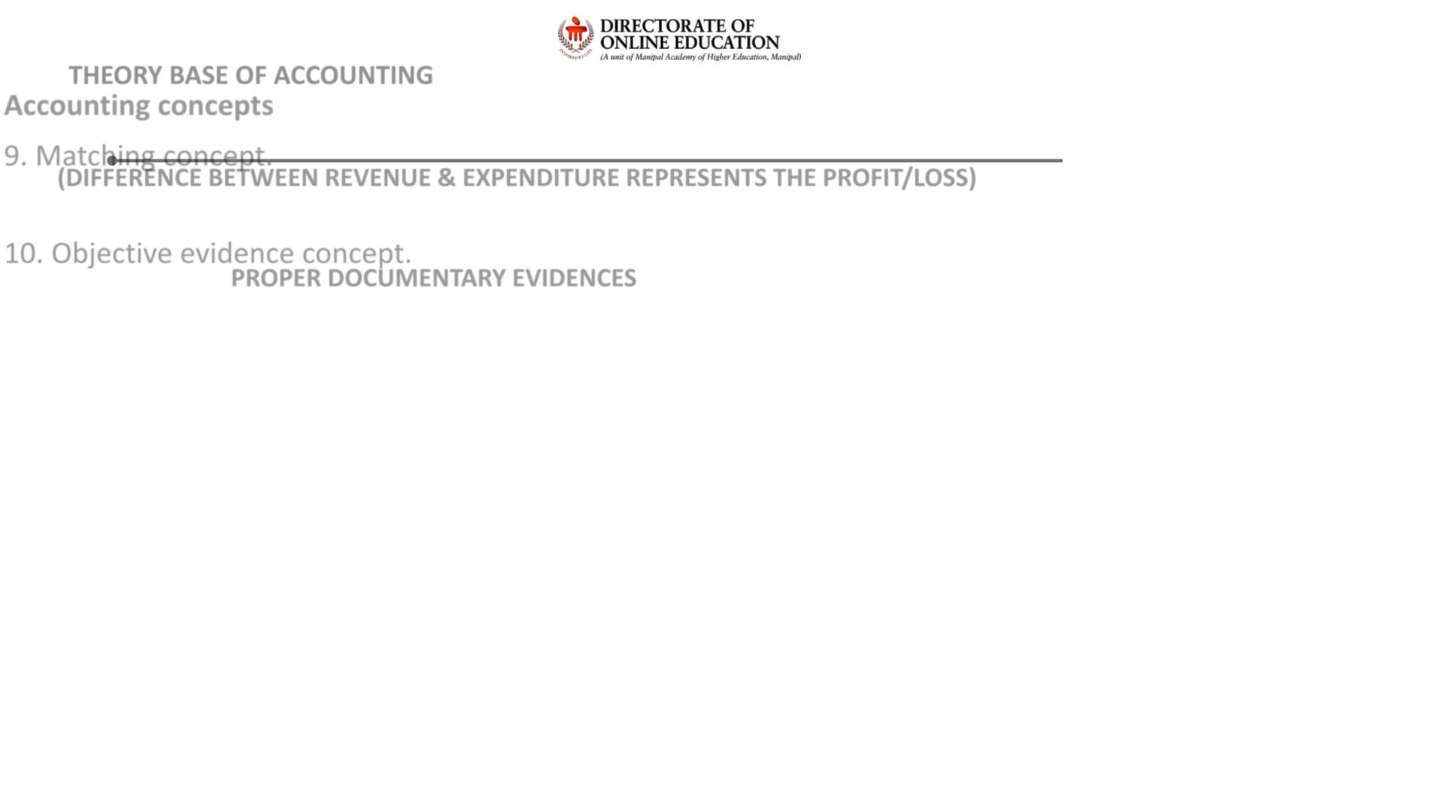
THEORY BASE OF ACCOUNTING
Accounting concepts
9. Matching concept.
(DIFFERENCE BETWEEN REVENUE & EXPENDITURE REPRESENTS THE PROFIT/LOSS)
10. Objective evidence concept.
PROPER DOCUMENTARY EVIDENCES

Slide 20
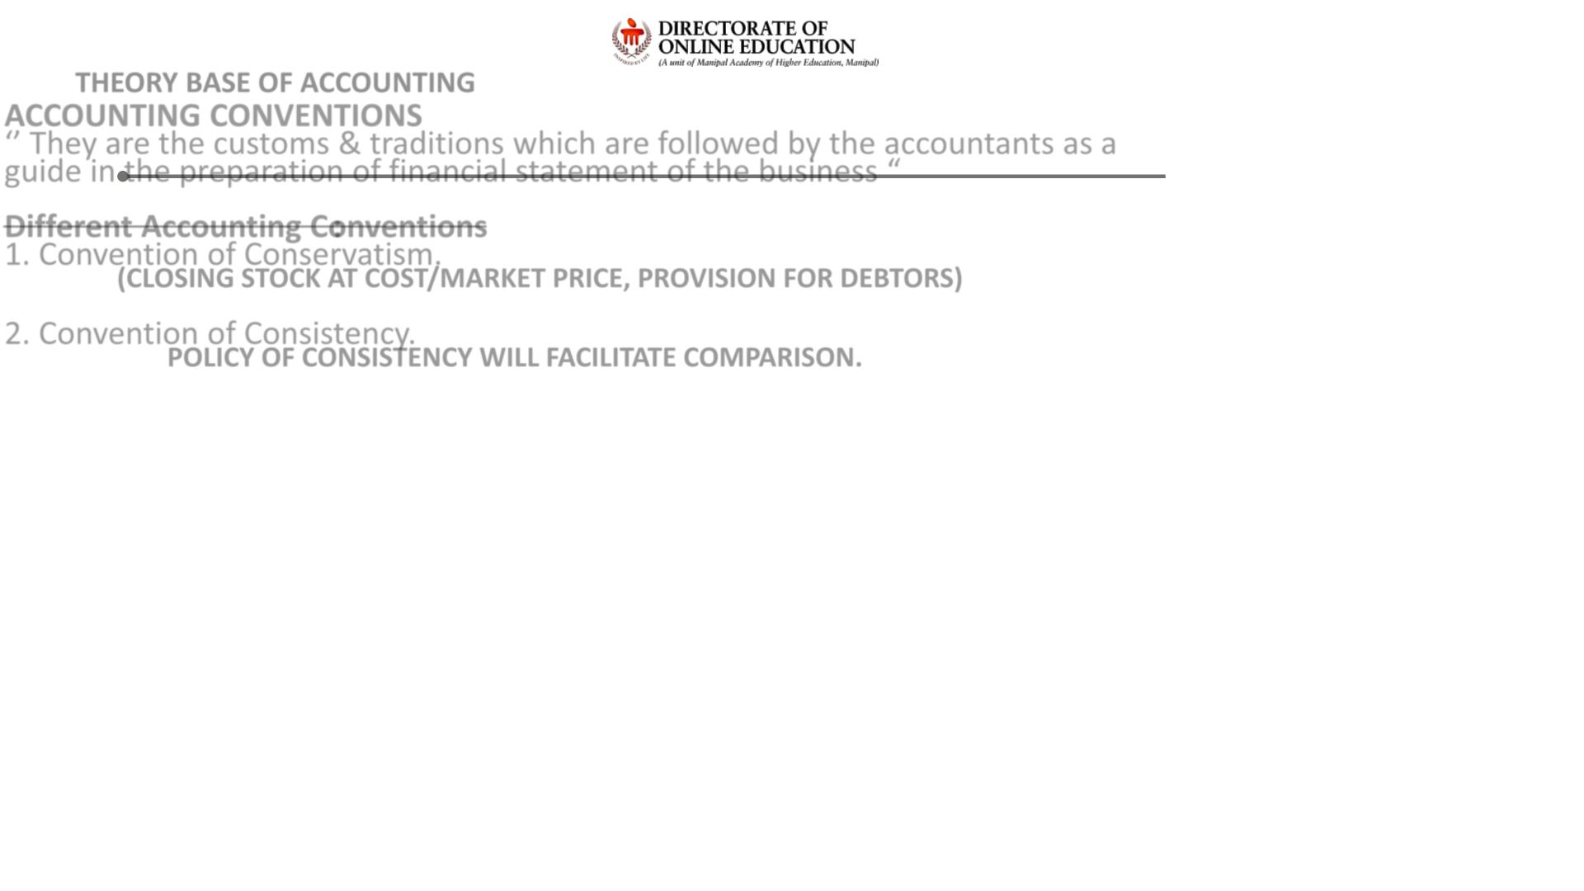
THEORY BASE OF ACCOUNTING
ACCOUNTING CONVENTIONS
‘’ They are the customs & traditions which are followed by the accountants as a
guide in the preparation of financial statement of the business “
Different Accounting Conventions:
1. Convention of Conservatism.
(CLOSING STOCK AT COST/MARKET PRICE, PROVISION FOR DEBTORS)
2. Convention of Consistency.
POLICY OF CONSISTENCY WILL FACILITATE COMPARISON.

Slide 21
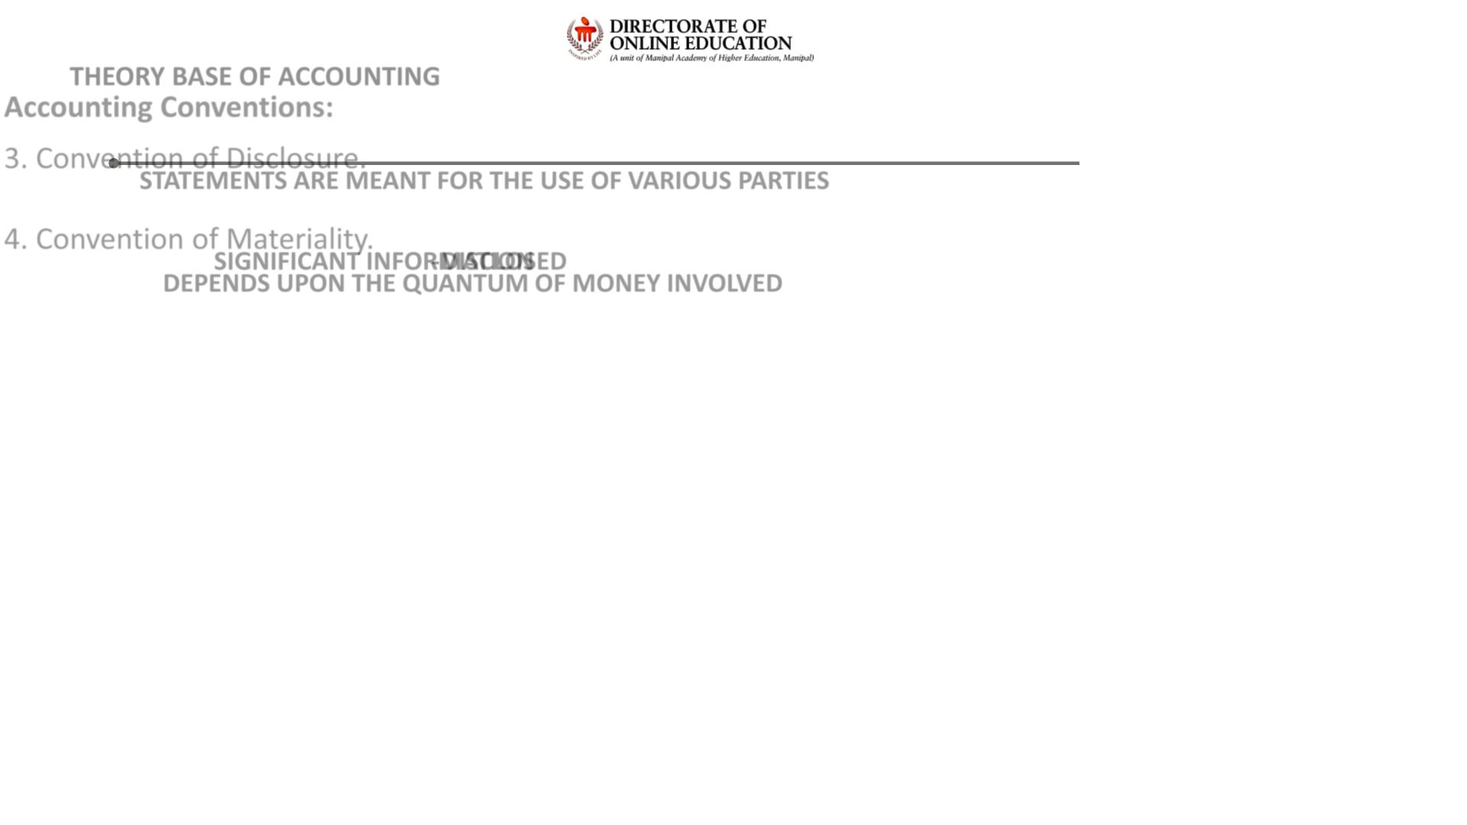
THEORY BASE OF ACCOUNTING
Accounting Conventions:
3. Convention of Disclosure.
STATEMENTS ARE MEANT FOR THE USE OF VARIOUS PARTIES
4. Convention of Materiality.
SIGNIFICANT INFORMATION - DISCLOSED
DEPENDS UPON THE QUANTUM OF MONEY INVOLVED

Slide 22
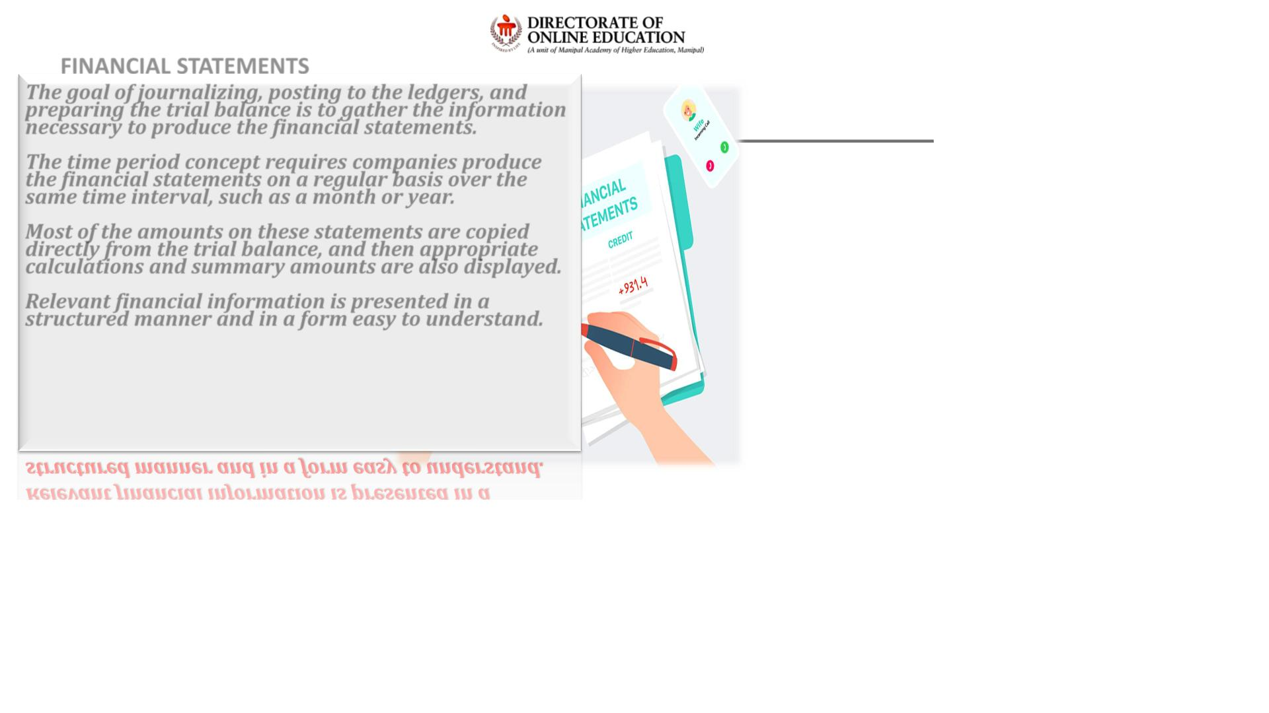
FINANCIAL STATEMENTS
The goal of journalizing, posting to the ledgers, and
preparing the trial balance is to gather the information
necessary to produce the financial statements.
The time period concept requires companies produce
the financial statements on a regular basis over the
same time interval, such as a month or year.
Most of the amounts on these statements are copied
directly from the trial balance, and then appropriate
calculations and summary amounts are also displayed.
Relevant financial information is presented in a
structured manner and in a form easy to understand.

Slide 23

FINANCIAL STATEMENTS
INCOME STATEMENTS
STATEMENT OF CHANGES IN EQUITY
BALANCE SHEET
CASH FLOW STATEMENT

Slide 24
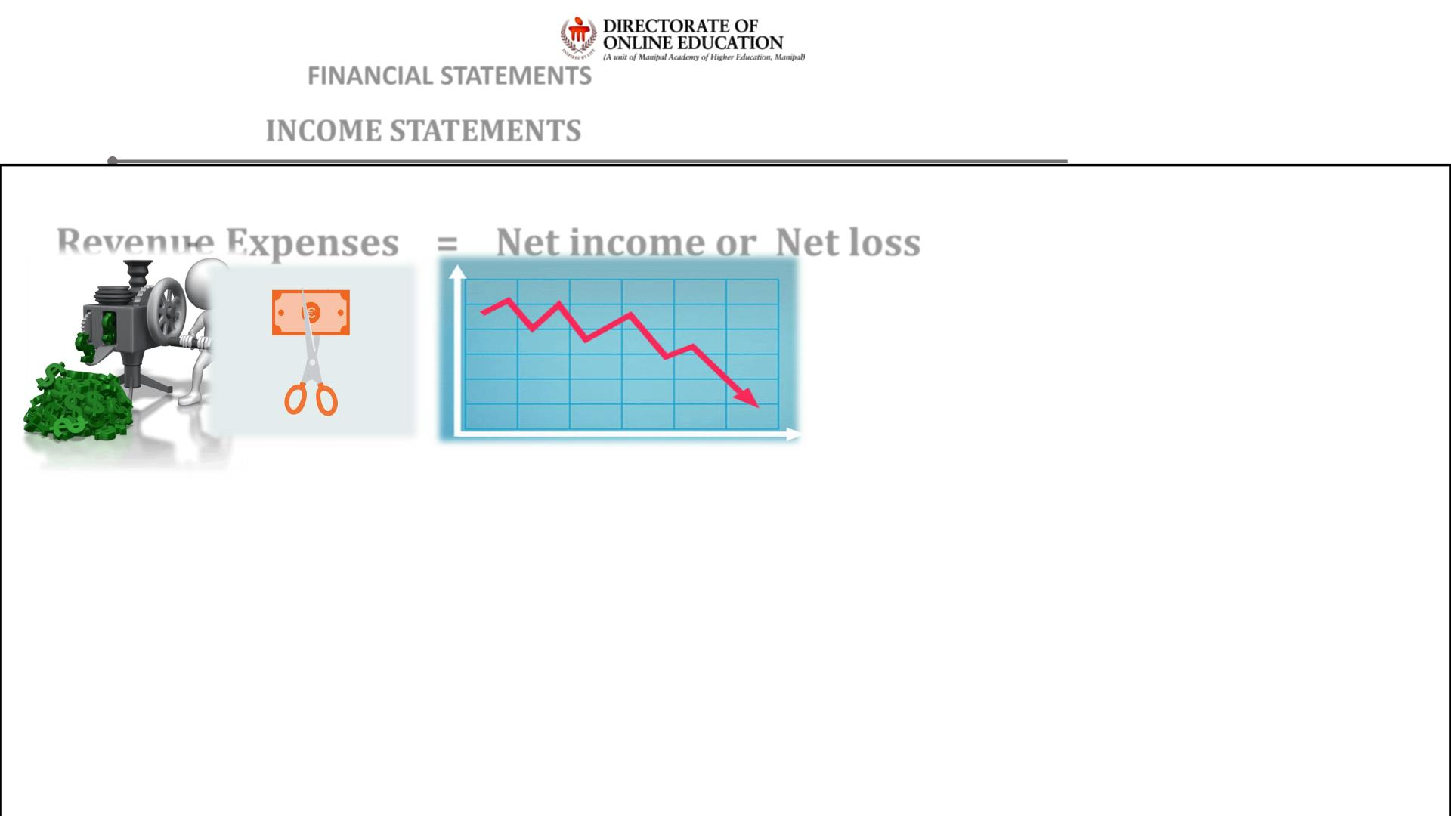
FINANCIAL STATEMENTS
INCOME STATEMENTS
Revenue - Expenses = Net income or Net loss

Slide 25
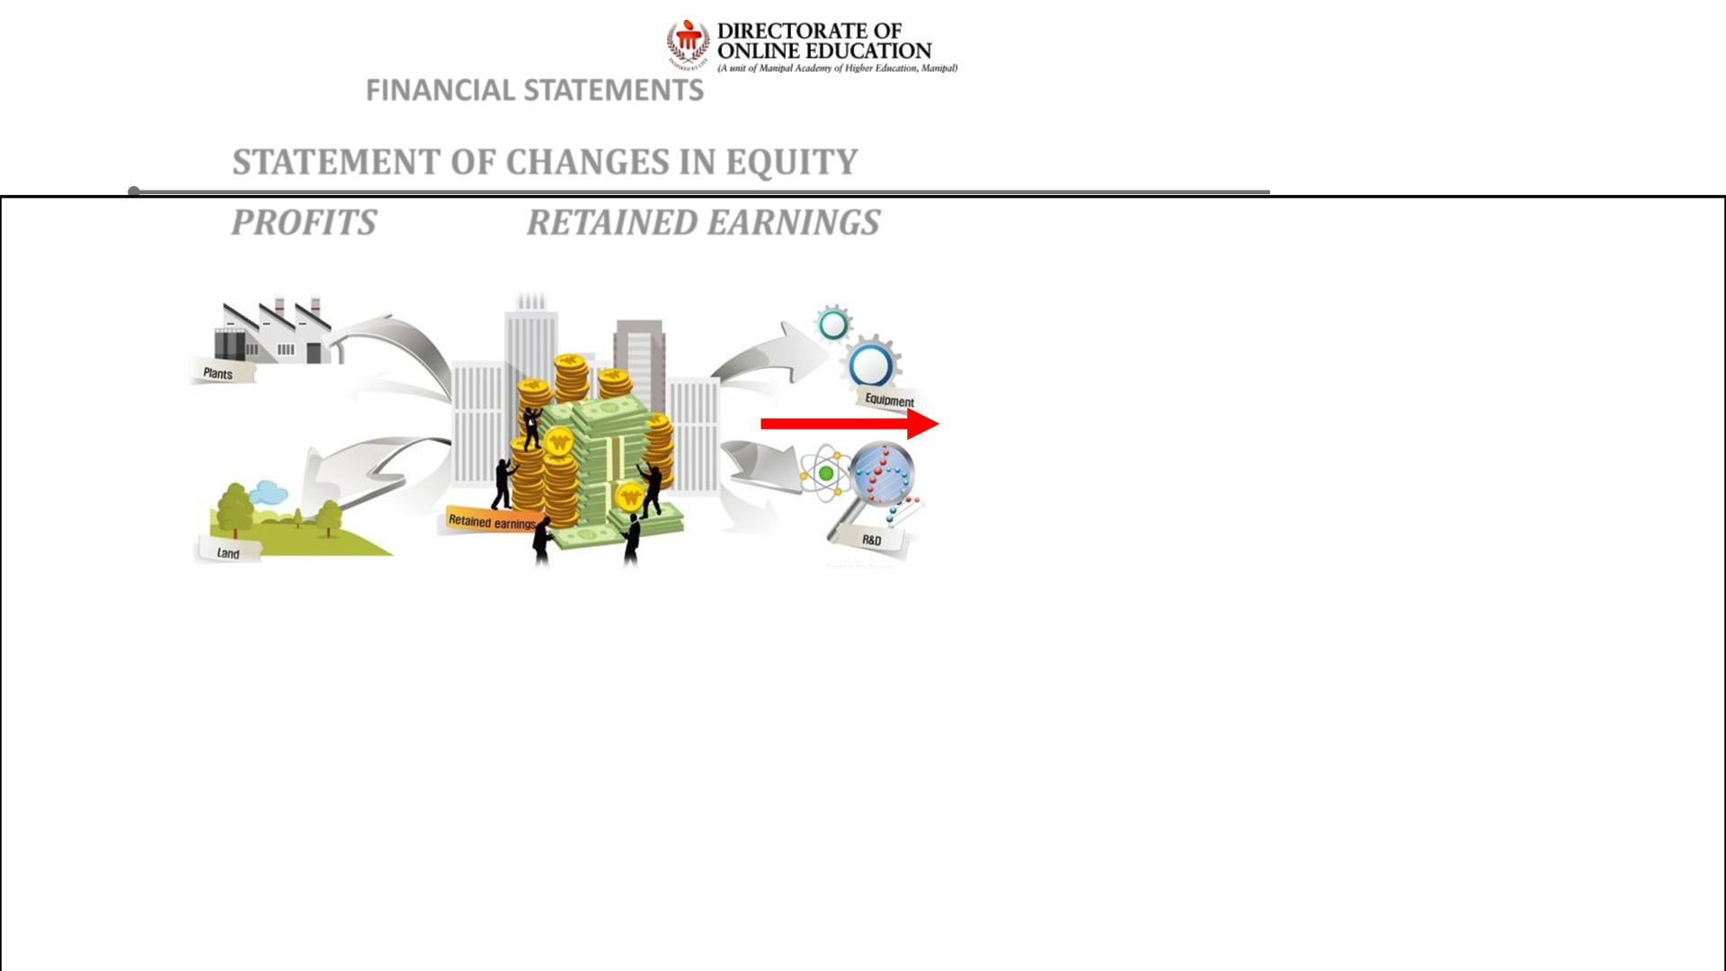
FINANCIAL STATEMENTS
STATEMENT OF CHANGES IN EQUITY
PROFITS
RETAINED EARNINGS

Slide 26
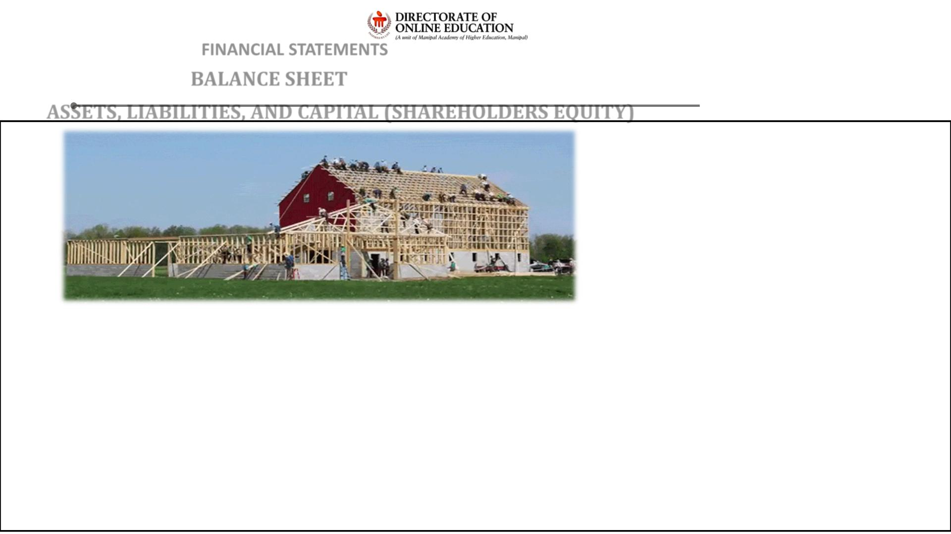
FINANCIAL STATEMENTS
BALANCE SHEET
ASSETS, LIABILITIES, AND CAPITAL (SHAREHOLDERS EQUITY)

Slide 27
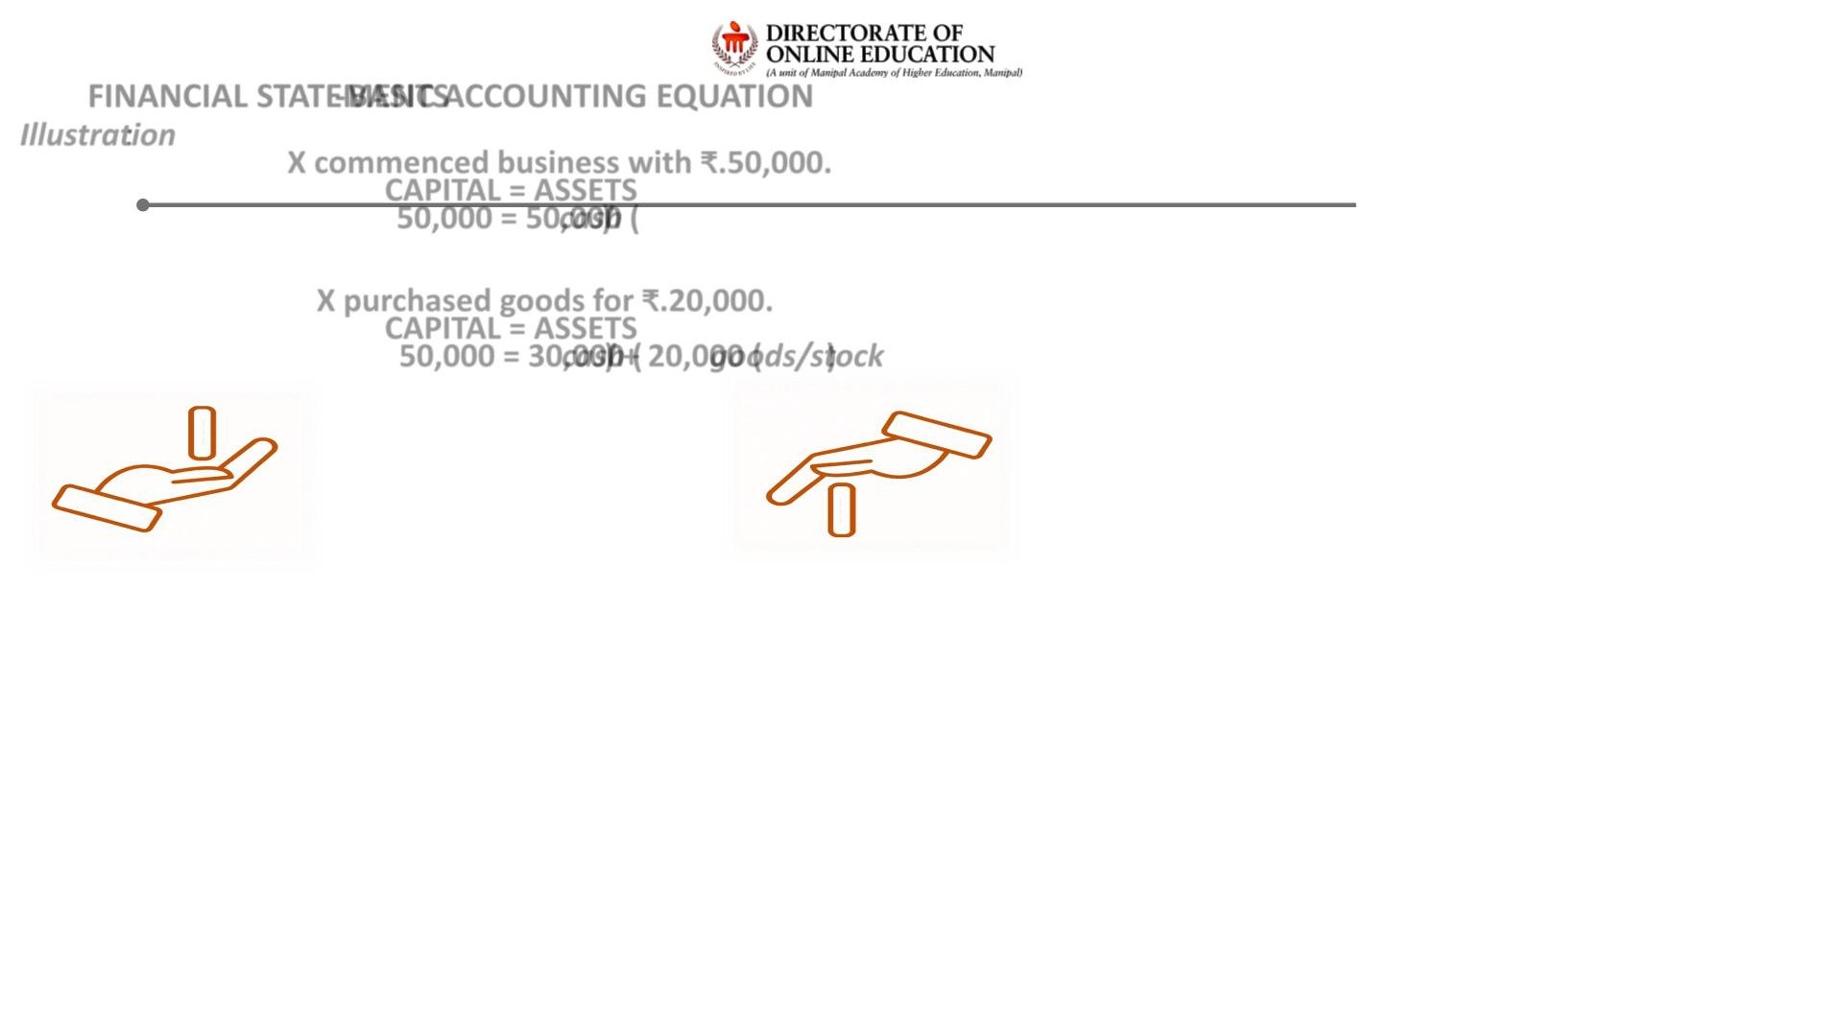
FINANCIAL STATEMENTS - BASIC ACCOUNTING EQUATION
Illustration:
X commenced business with ₹.50,000.
CAPITAL = ASSETS
50,000 = 50,000 (cash)
X purchased goods for ₹.20,000.
CAPITAL = ASSETS
50,000 = 30,000 (cash) + 20,000 (goods/stock)

Slide 28
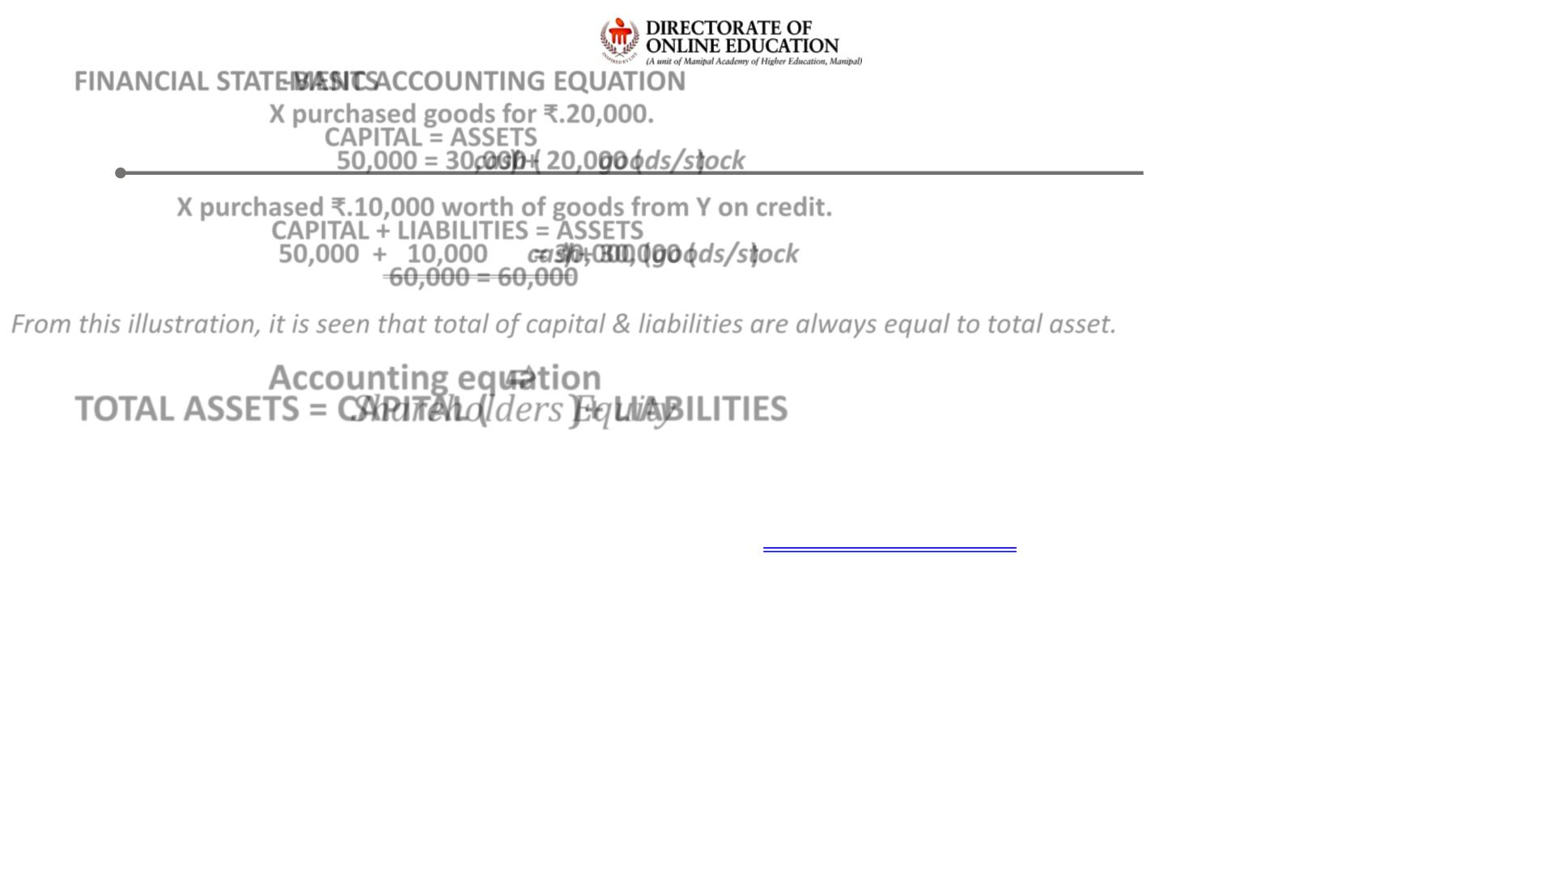
FINANCIAL STATEMENTS - BASIC ACCOUNTING EQUATION
X purchased goods for ₹.20,000.
CAPITAL = ASSETS
50,000 = 30,000 (cash) + 20,000 (goods/stock)
X purchased ₹.10,000 worth of goods from Y on credit.
CAPITAL + LIABILITIES = ASSETS
50,000 + 10,000 = 30,000 (cash) + 30,000 (goods/stock)
60,000 = 60,000
From this illustration, it is seen that total of capital & liabilities are always equal to total asset.
Accounting equation 
TOTA L ASSETS = CAPITAL (Shareholders Equity) + LIABILITIES

Slide 29
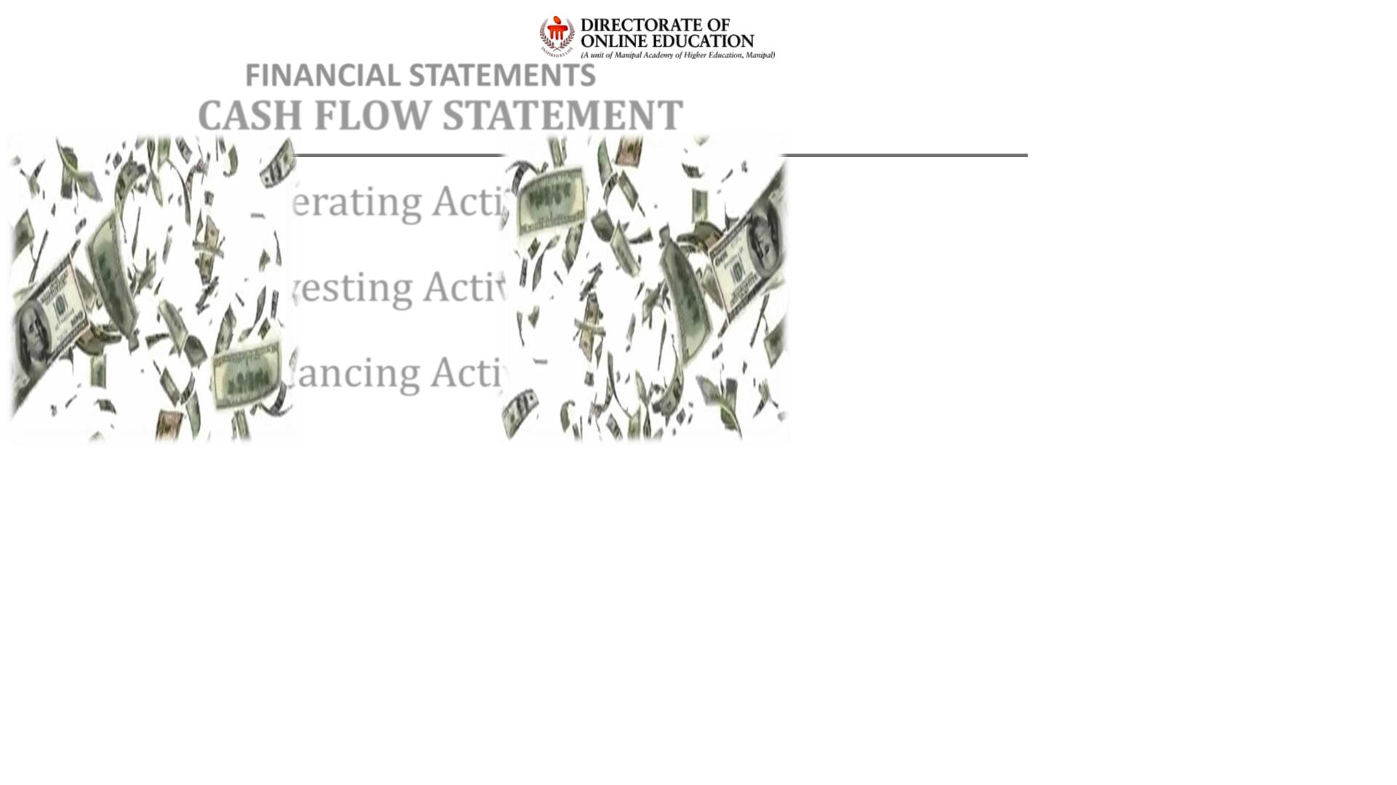
FINANCIAL STATEMENTS
CASH FLOW STATEMENT
Operating Activities
Investing Activities
Financing Activities

Slide 30
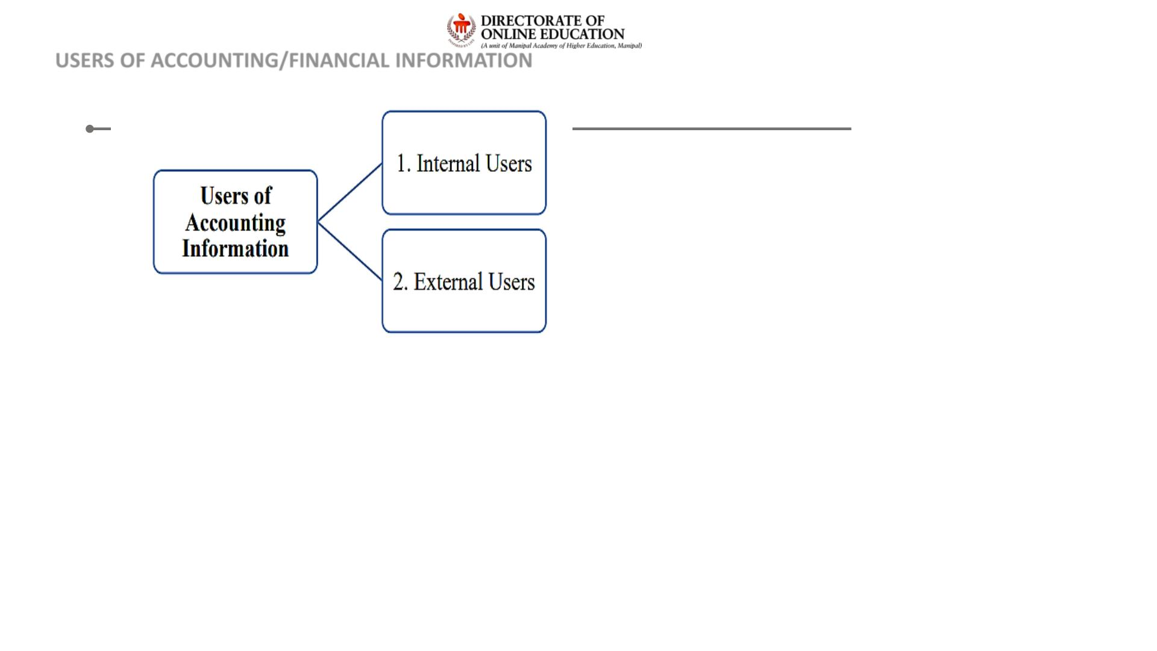
USERS OF ACCOUNTING/FINANCIAL INFORMATION

Slide 31
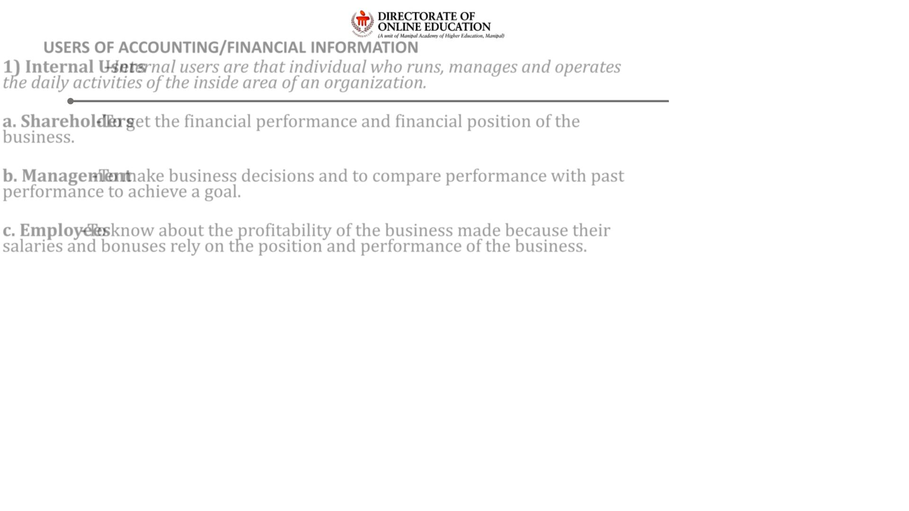
USERS OF ACCOUNTING/FINANCIAL INFORMATION
1) Internal Users – Internal users are that individual who runs, manages and operates
the daily activities of the inside area of an organization.
a. Shareholders - To get the financial performance and financial position of the
business.
b. Management- To make business decisions and to compare performance with past
performance to achieve a goal.
c. Employees - To know about the profitability of the business made because their
salaries and bonuses rely on the position and performance of the business.

Slide 32
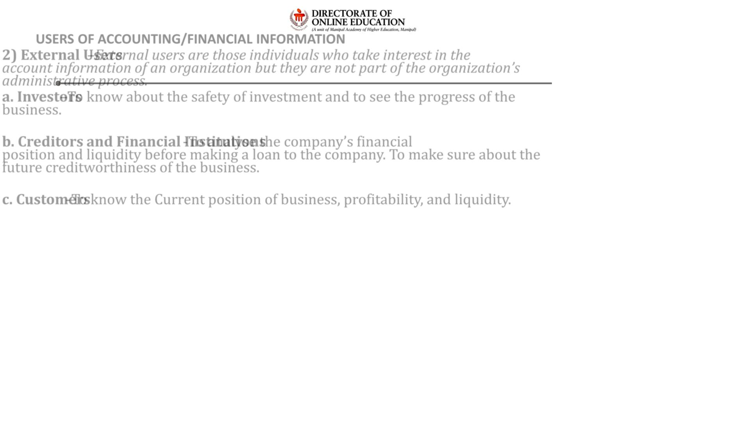
USERS OF ACCOUNTING/FINANCIAL INFORMATION
2) External Users – External users are those individuals who take interest in the
account information of an organization but they are not part of the organization’s
administrative process.
a. Investors – To know about the safety of investment and to see the progress of the
business.
b. Creditors and Financial Institutions - To analyse the company’s financial
position and liquidity before making a loan to the company. To make sure about the
future creditworthiness of the business.
c. Customers - To know the Current position of business, profitability, and liquidity.

Slide 33
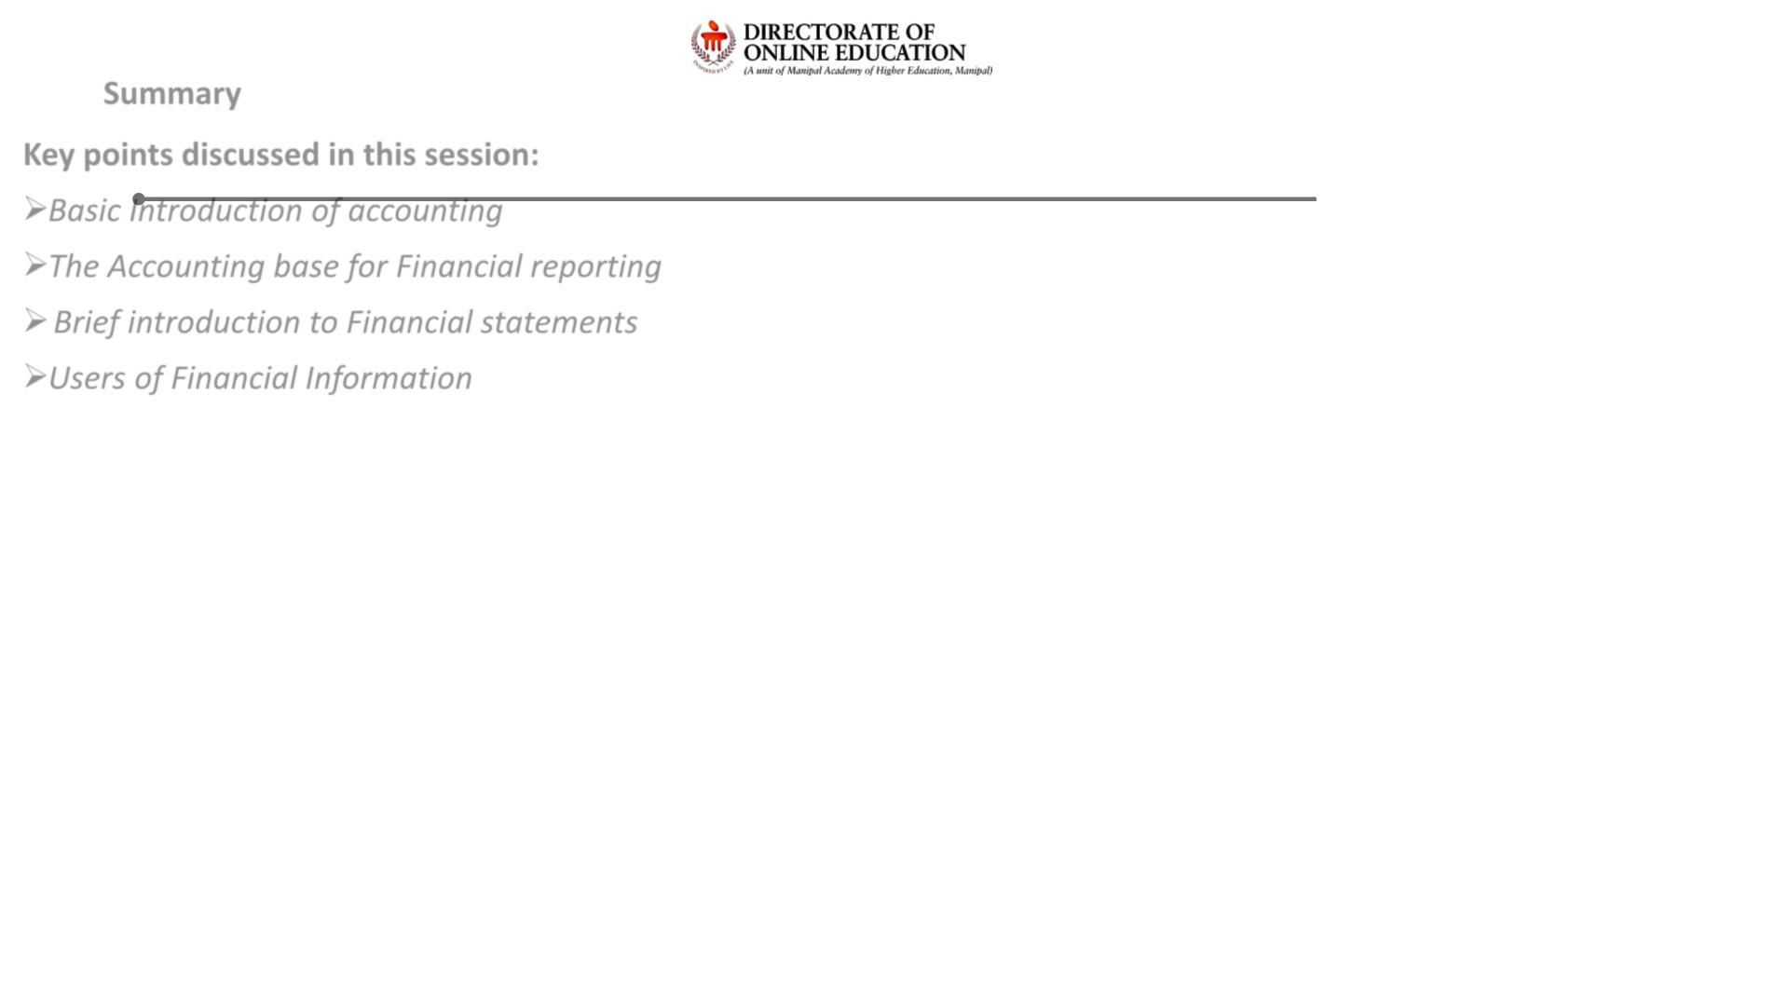
Summary
Key points discussed in this session:
➢ Basic Introduction of accounting
➢ The Accounting base for Financial reporting
➢ Brief introduction to Financial statements
➢ Users of Financial Information

Slide 34
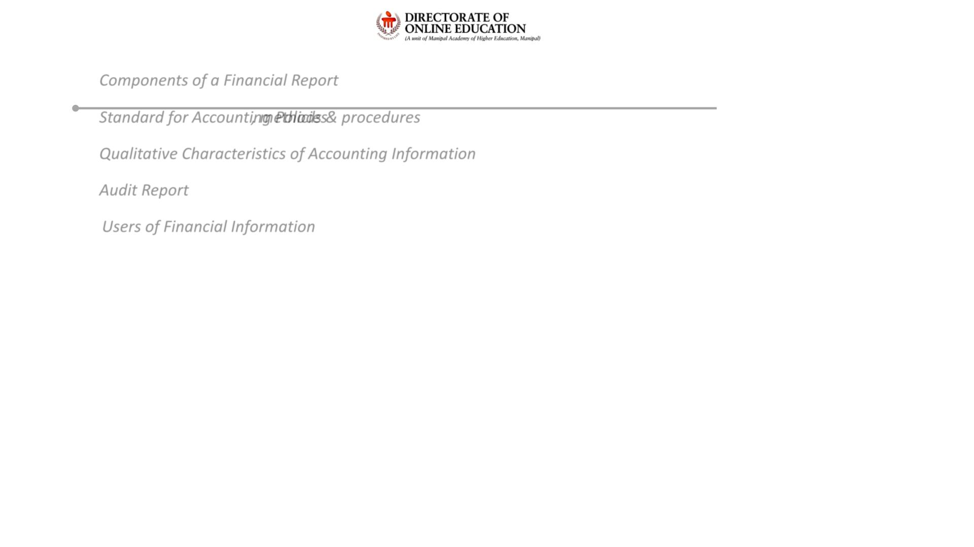
Important Questions
Question 1: Components of a Financial Report
Question 2: Standard for Accounting Policies, methods & procedures
Question 3: Qualitative Characteristics of Accounting Information
Question 4: Audit Report
Question 5: Users of Financial Information

Slide 35

References
E - Book References:
❖ https://open.umn.edu/opentextbooks/textbooks/financial-accounting
❖ https://open.umn.edu/opentextbooks/textbooks/principles-of-financial-accounting

